Slide 1


Exposure CS 2021
for CS1
Chapter 9 Section 1-6 Slides
Modular Programming: Simple Procedures,
Graphics Programs and Creating Libraries
PowerPoint Presentation
created by:
Mr. John L. M. Schram
and Mr. Leon Schram
Authors of Exposure
Computer Science

Slide 2
Section 9.1
Introduction

Slide 3

Creating Tools
It is in the nature of people to create things that make our lives simpler and more enjoyable.
To that end, it is also in the nature
of people to create tools to make
this process easier and more efficient.

Slide 4
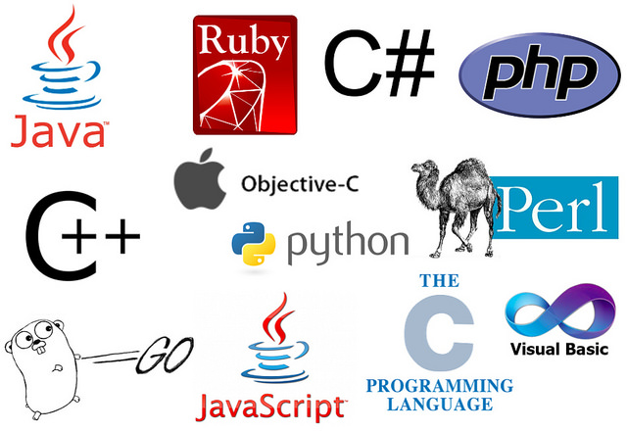
Program Subroutines
A subroutine is a series of programming commands that
performs a specific task (like a tool).
Once a subroutine is created,
it is no longer necessary to use
all the individual commands.
Subroutines have many names in
different programming languages.
For example, Java calls their subroutines methods.
In Python:
A subroutine that returns a value is called a function.
A subroutine that does not return a value is called a procedure.

Slide 5
Section 9.2
What is Modular
Programming?

Slide 6
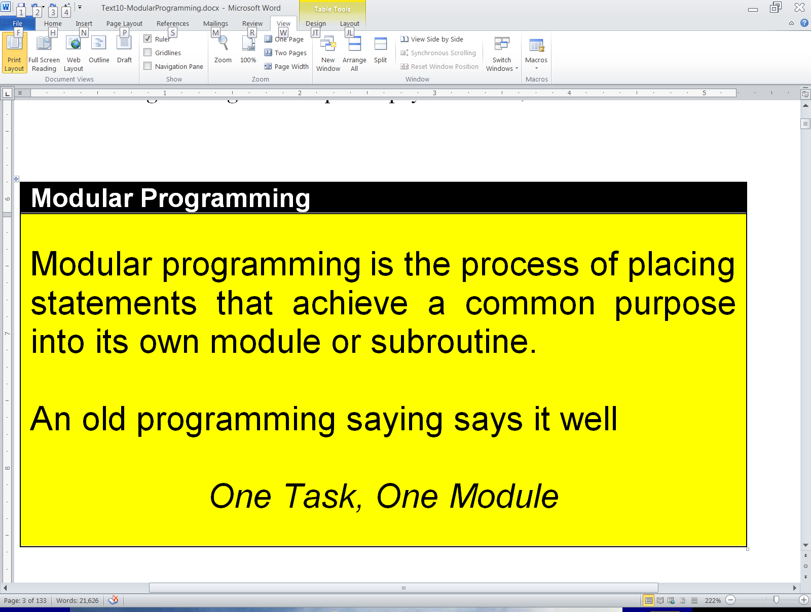
Modular Programming

Slide 7
Section 9.3
Creating Simple
Procedures

Slide 8
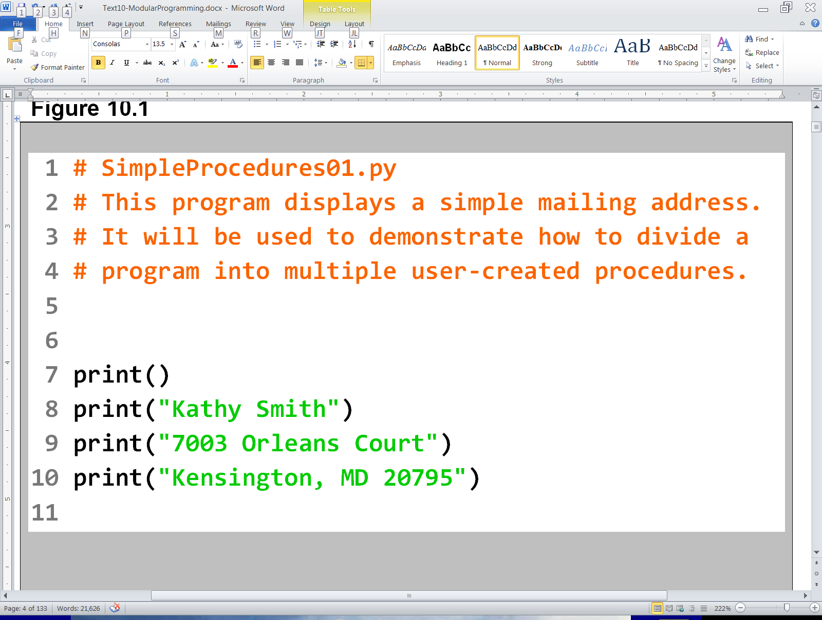
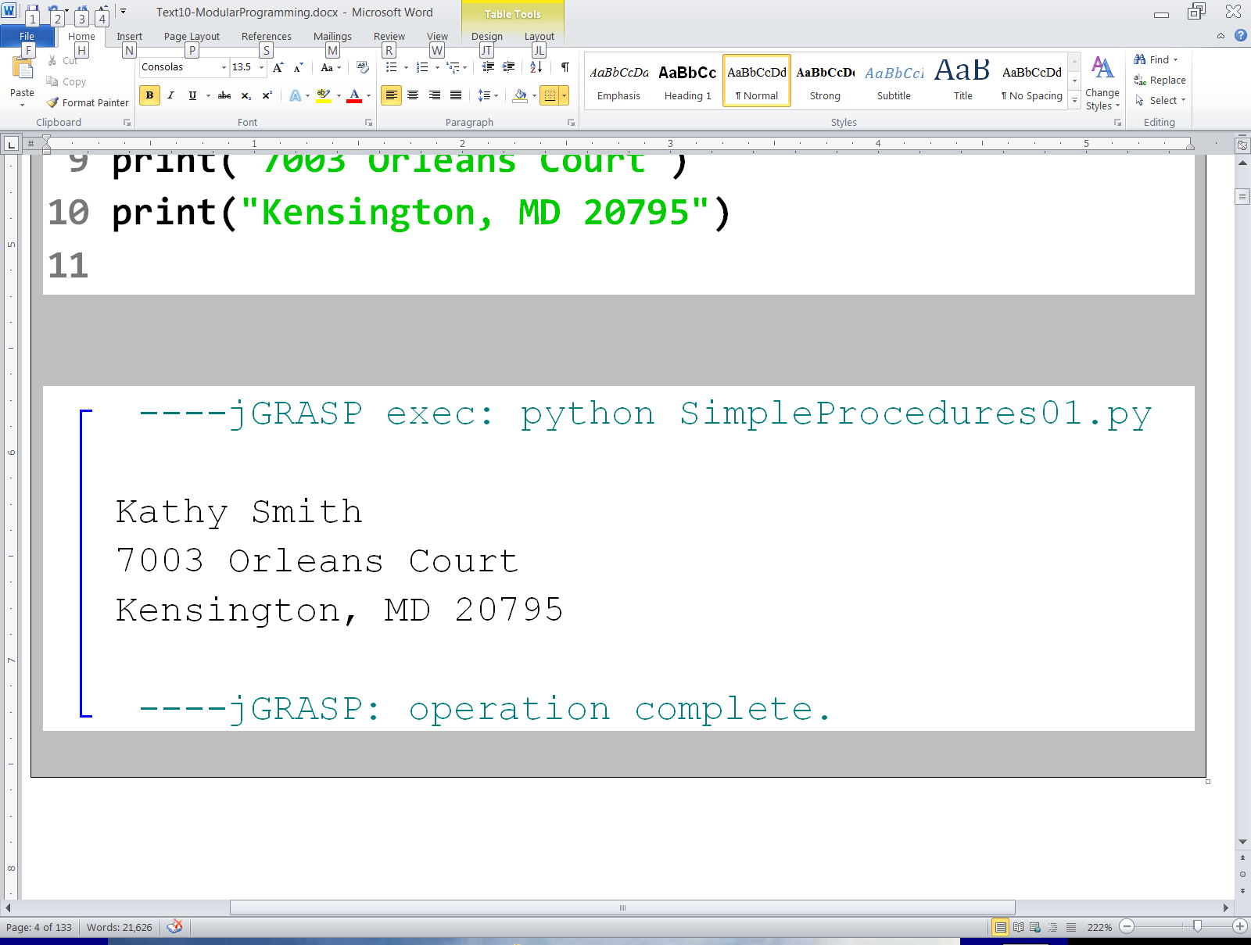

Slide 9
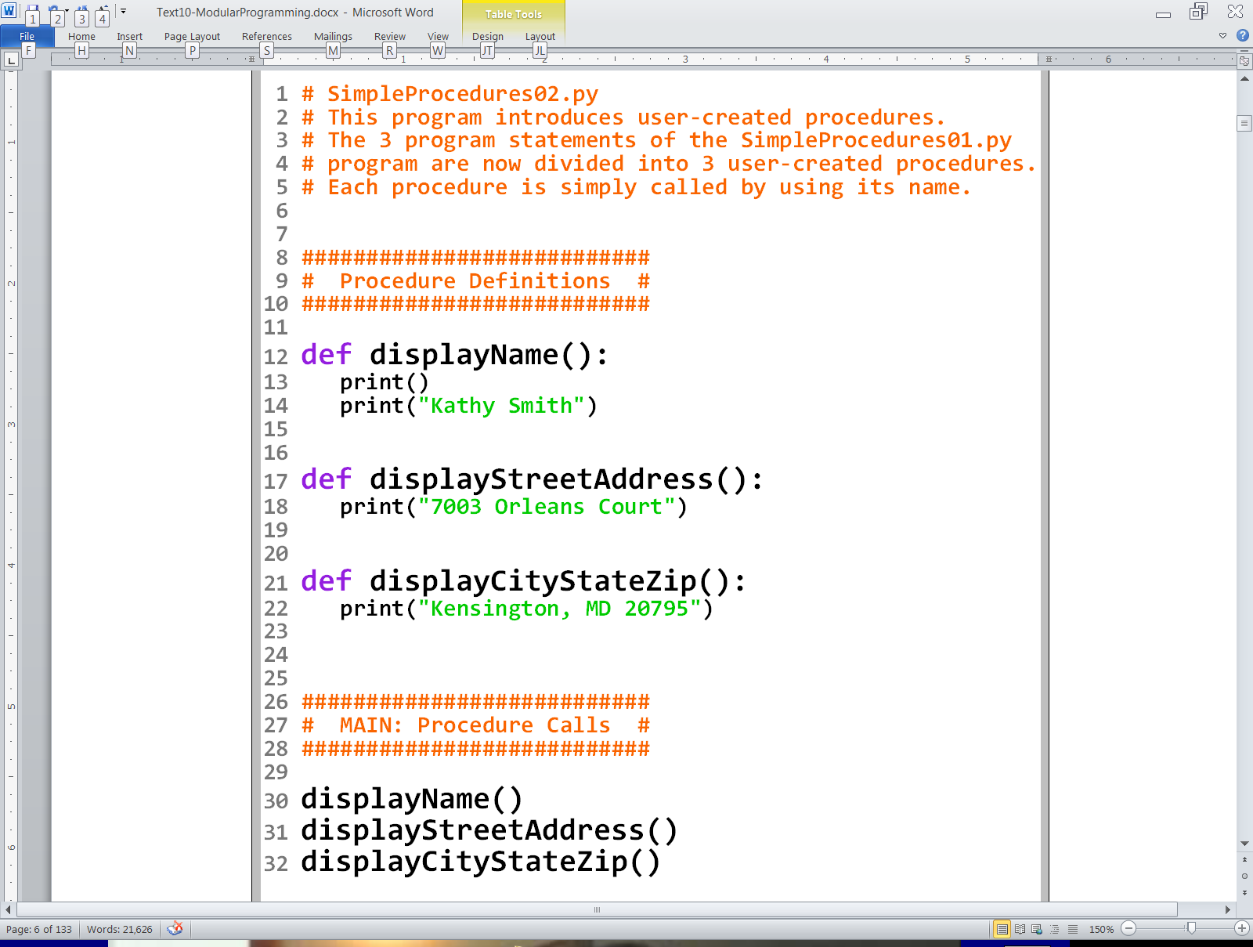

Slide 10
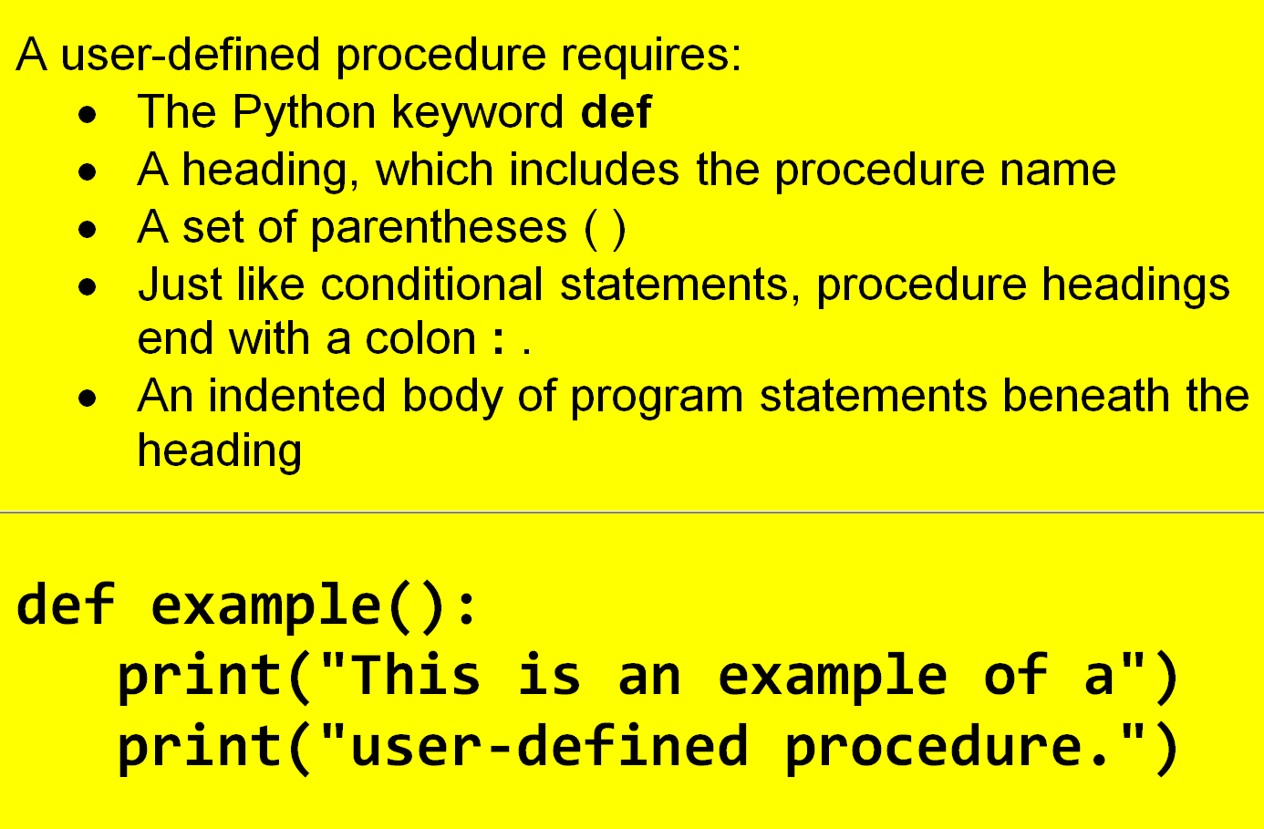
User-Created Procedure Format

Slide 11
Potential
Procedure
Problems

Slide 12
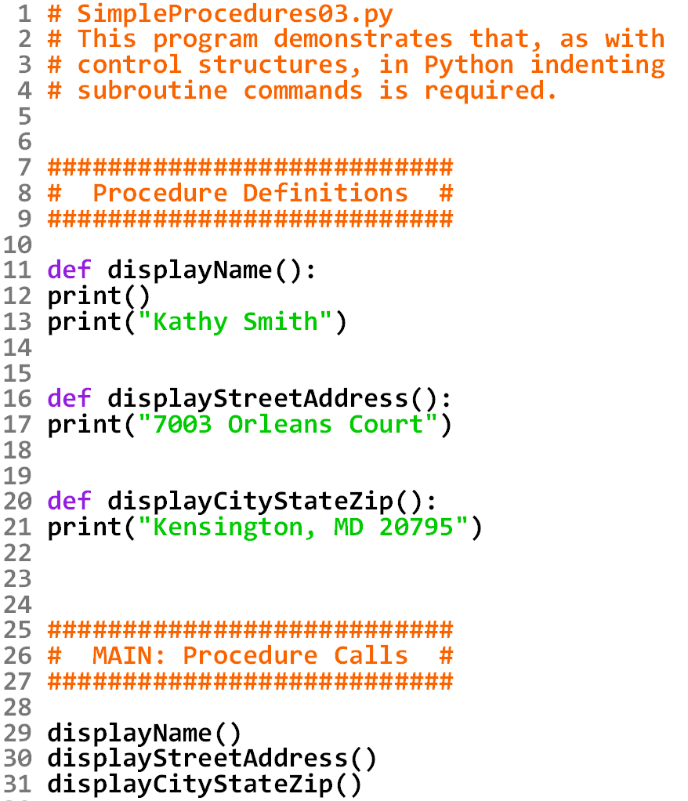

Slide 13
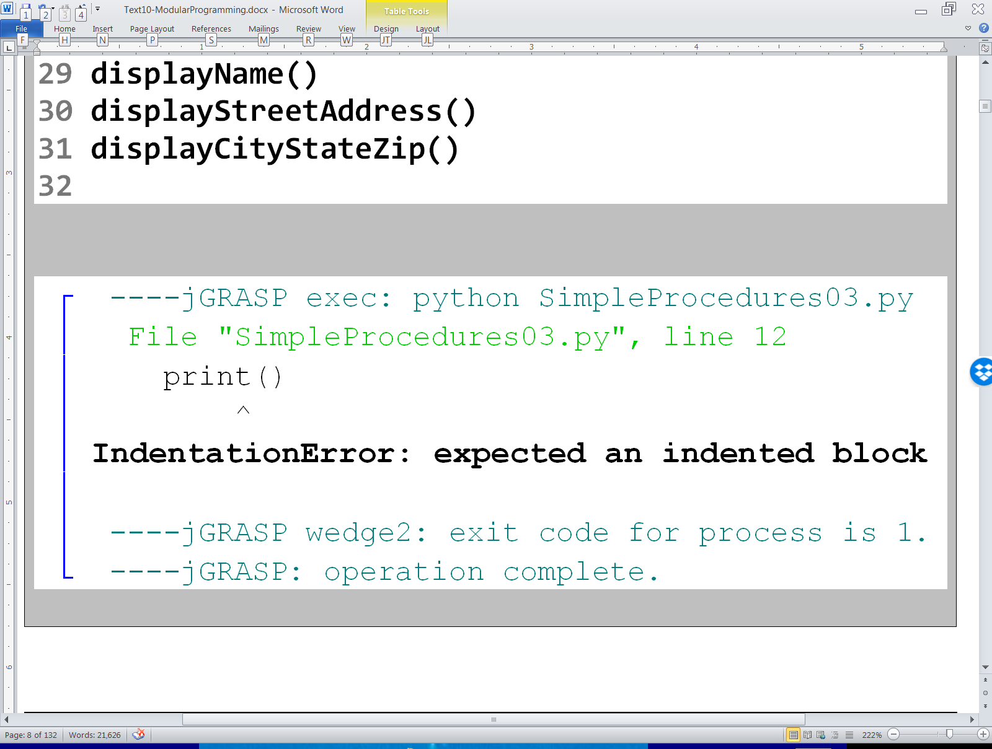

Slide 14
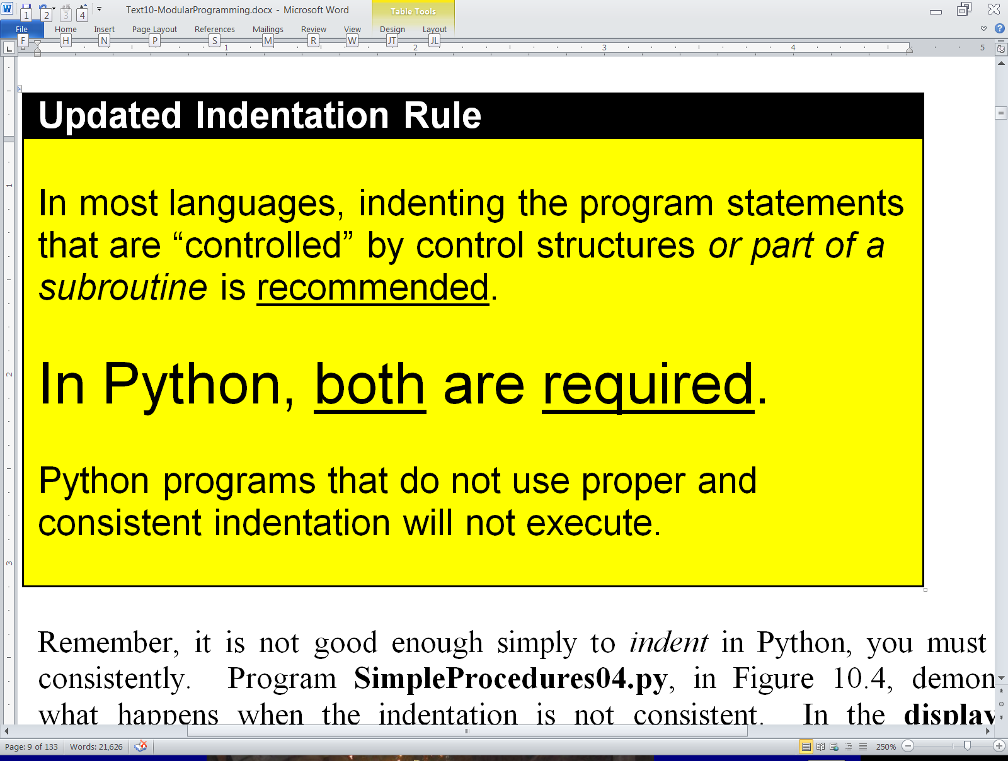
Updated Indentation Rule

Slide 15
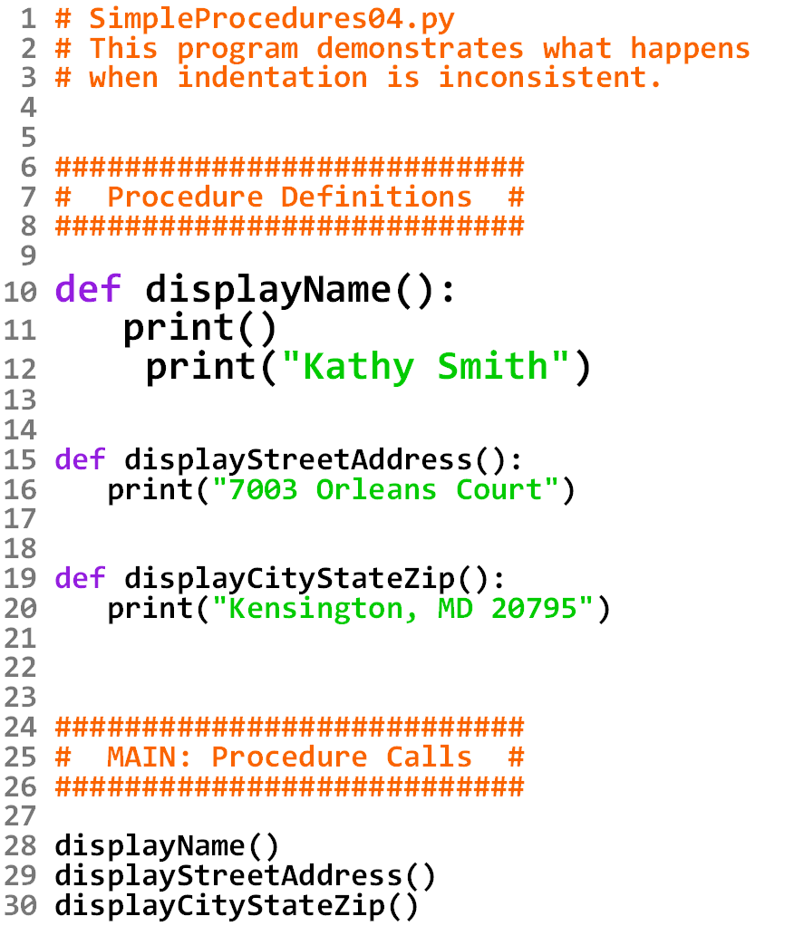

Slide 16
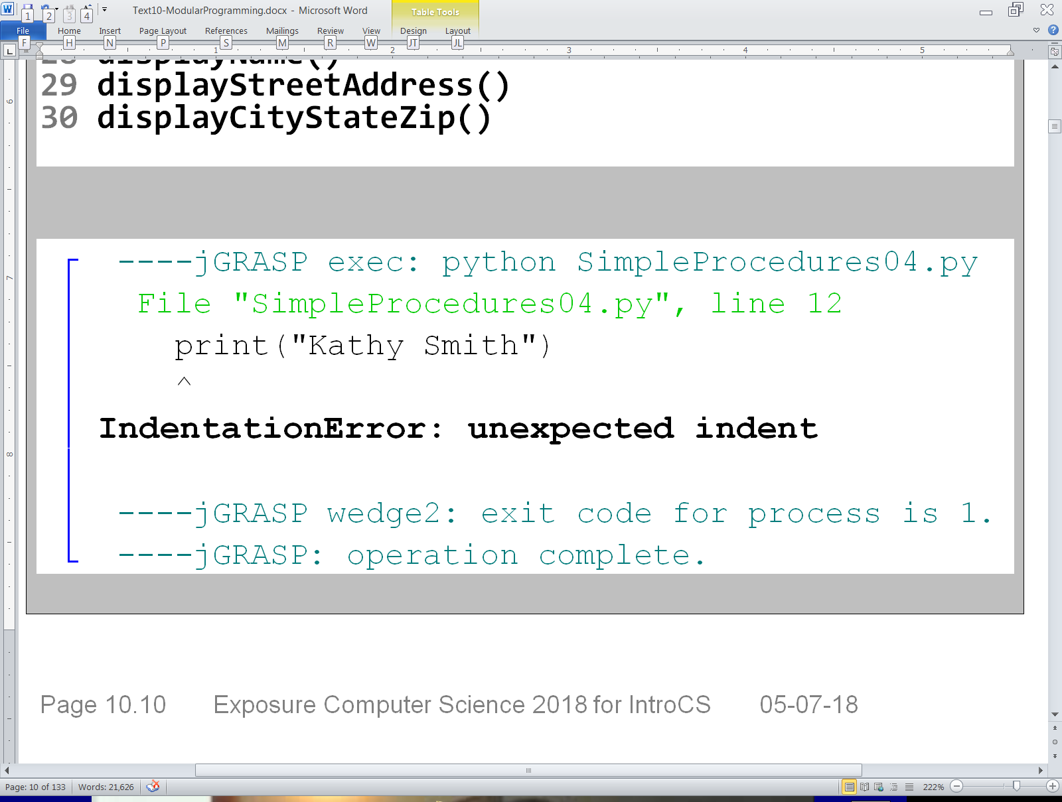

Slide 17
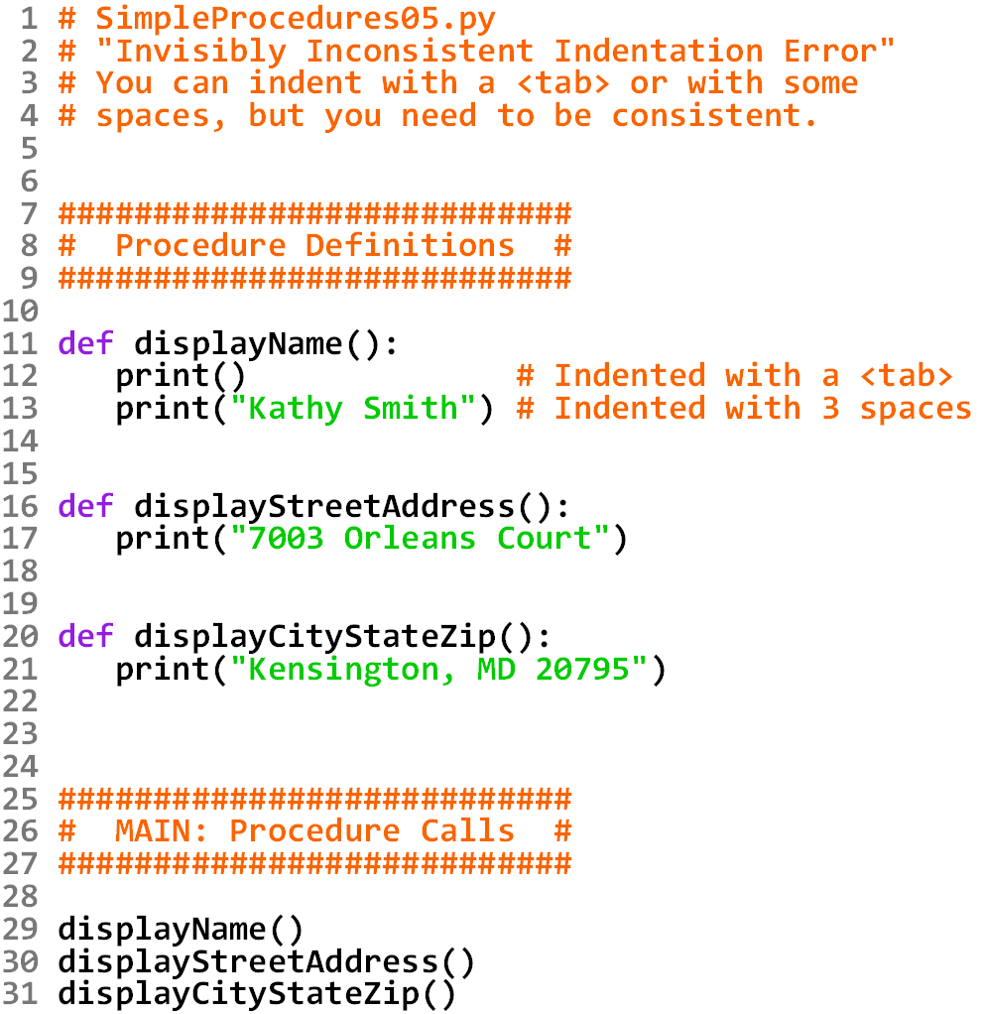

Slide 18
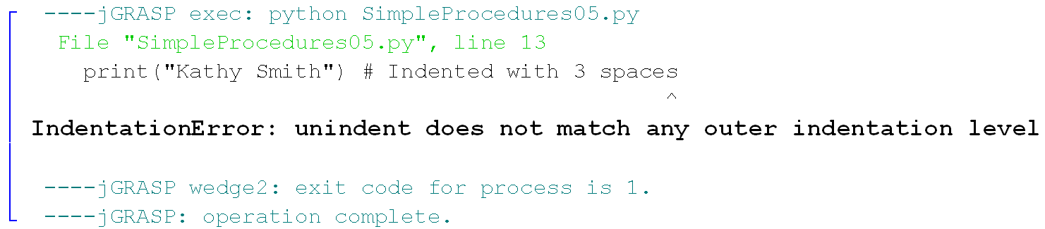

Slide 19

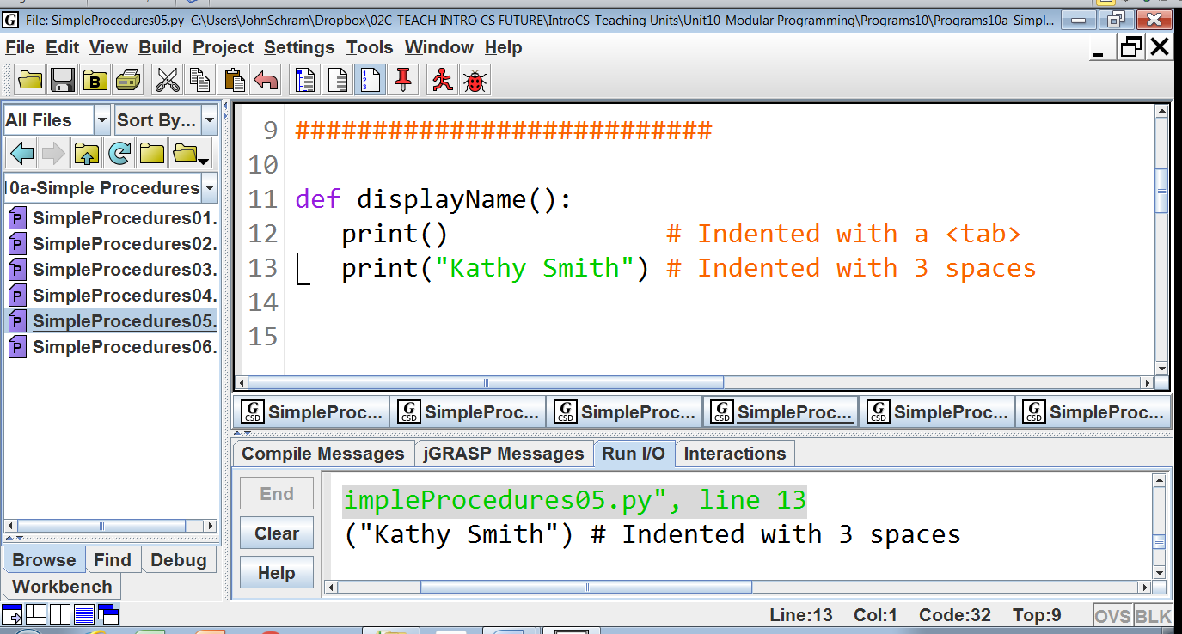

TRY THIS:
Click at the beginning of lines
12 and 13. Notice how the
cursor appears different on
line 12. This is because that
line is indented with a <tab>.

Slide 20
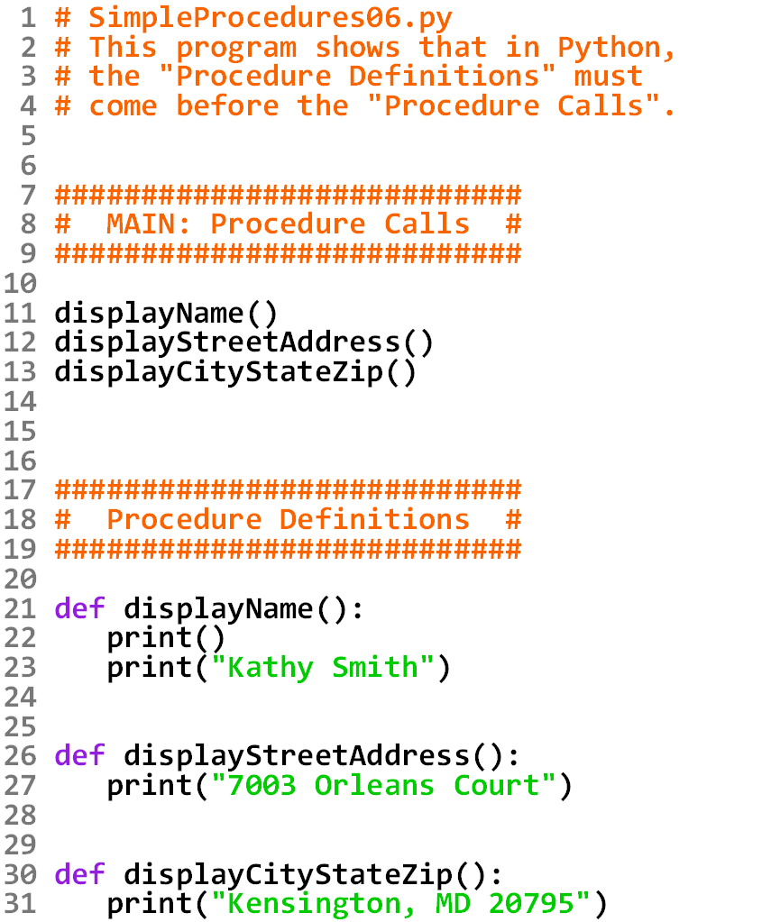


Slide 21
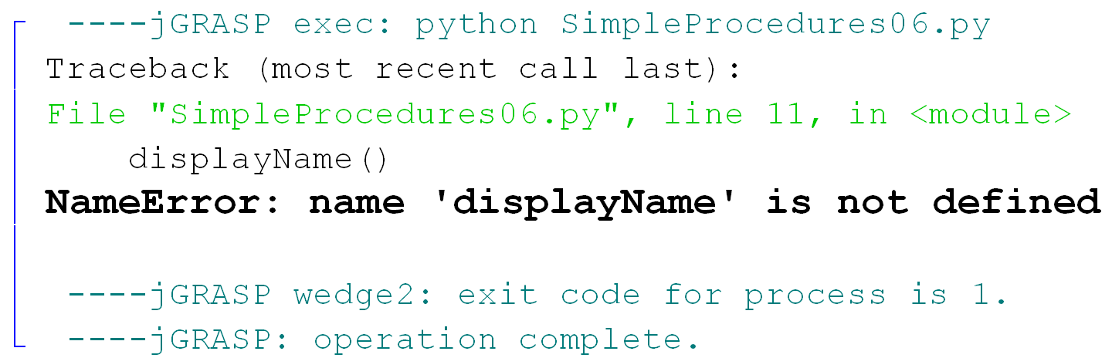

Slide 22
Section 9.4
Graphics Programs
with Procedures

Slide 23
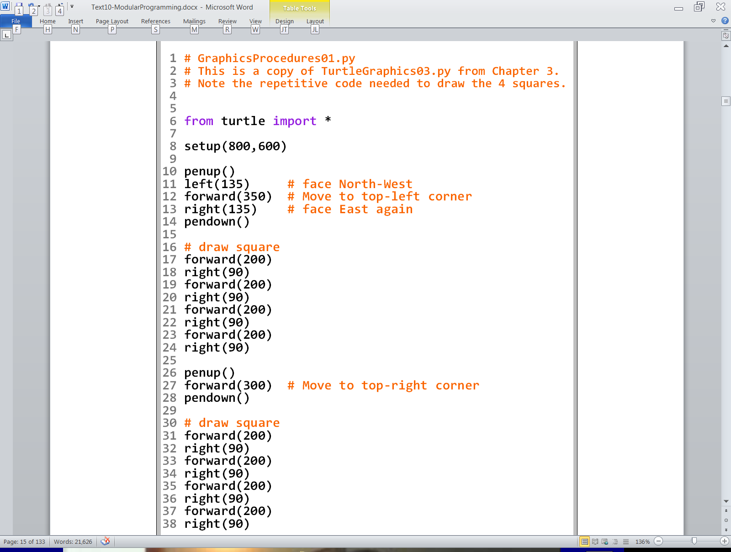
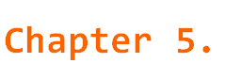
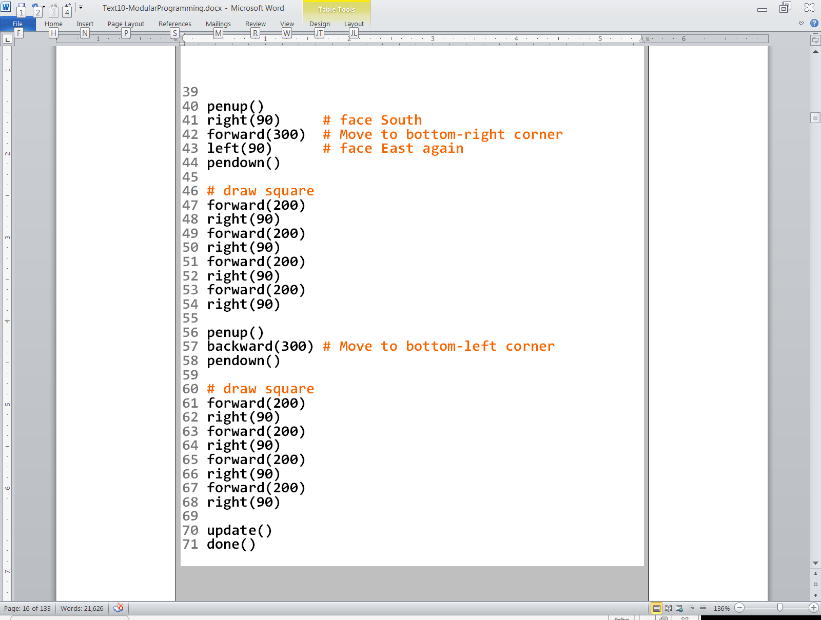

Slide 24
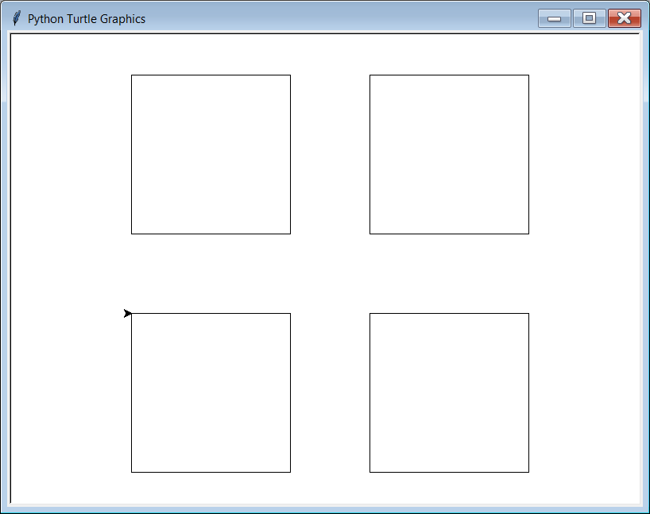

Slide 25
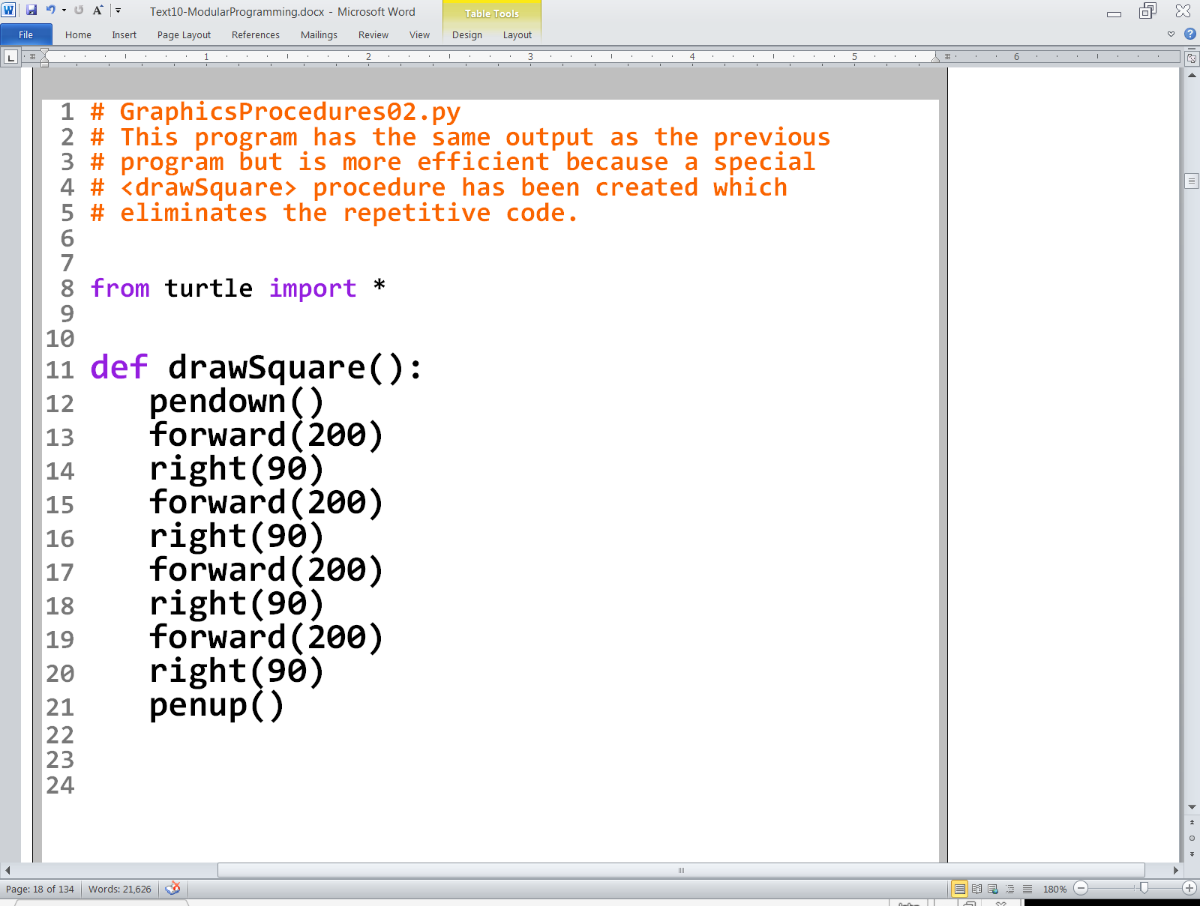
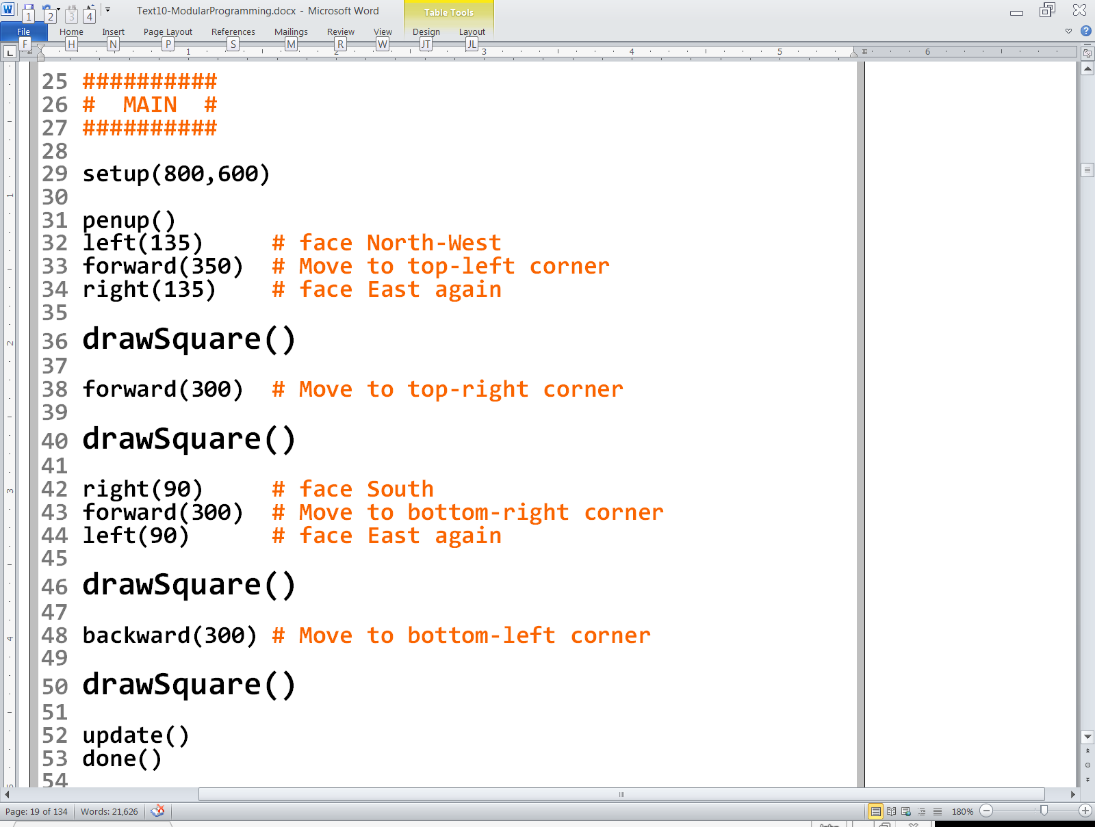

Slide 26
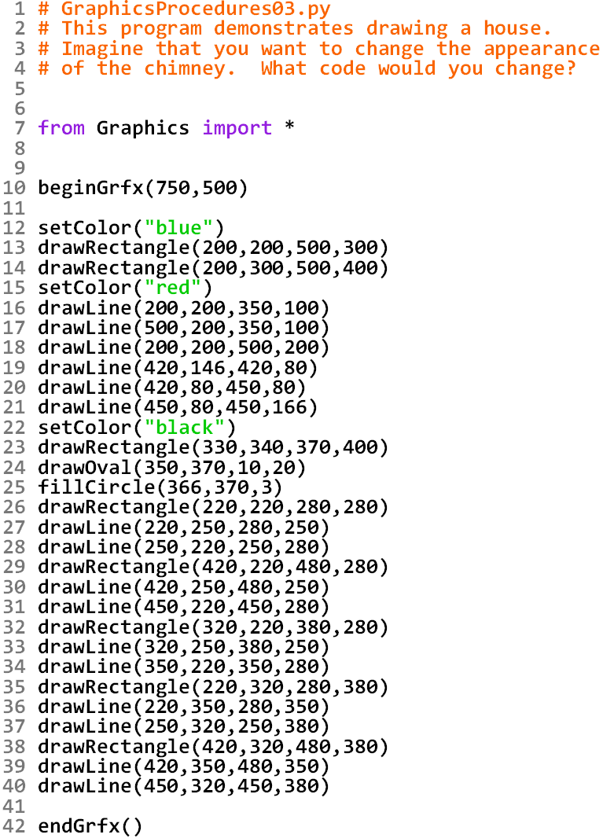
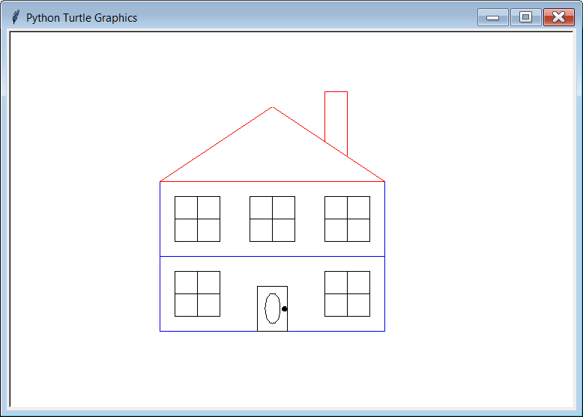
NOTE: This is NOT
Good Program Design.

Slide 27
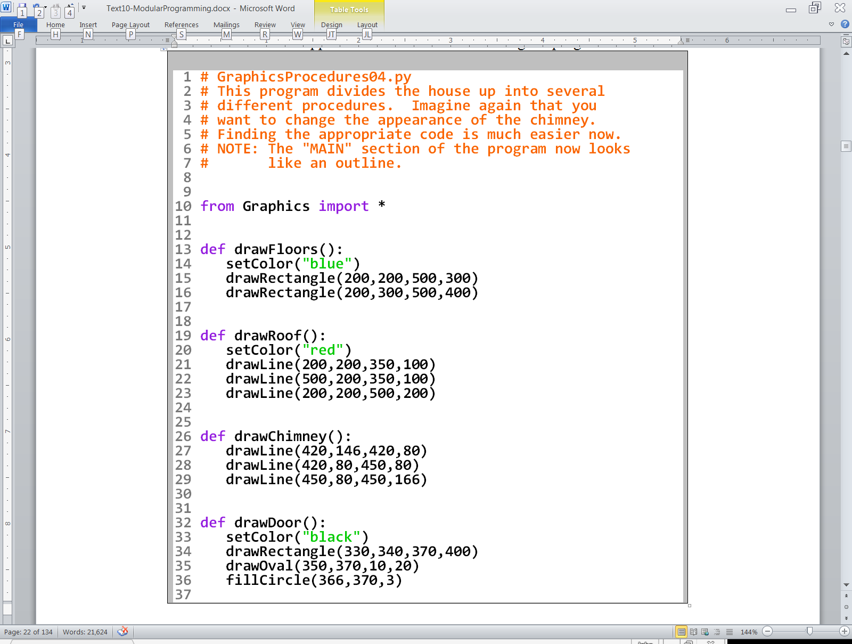
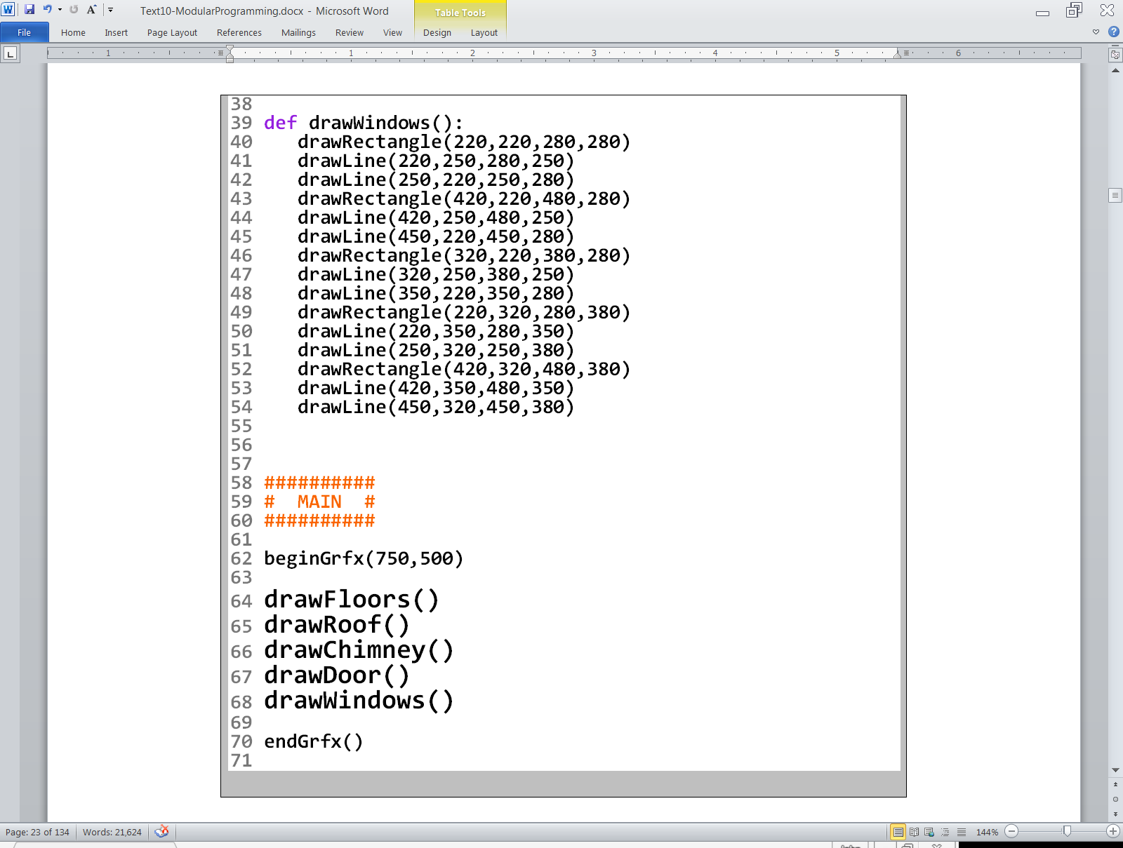

Slide 28
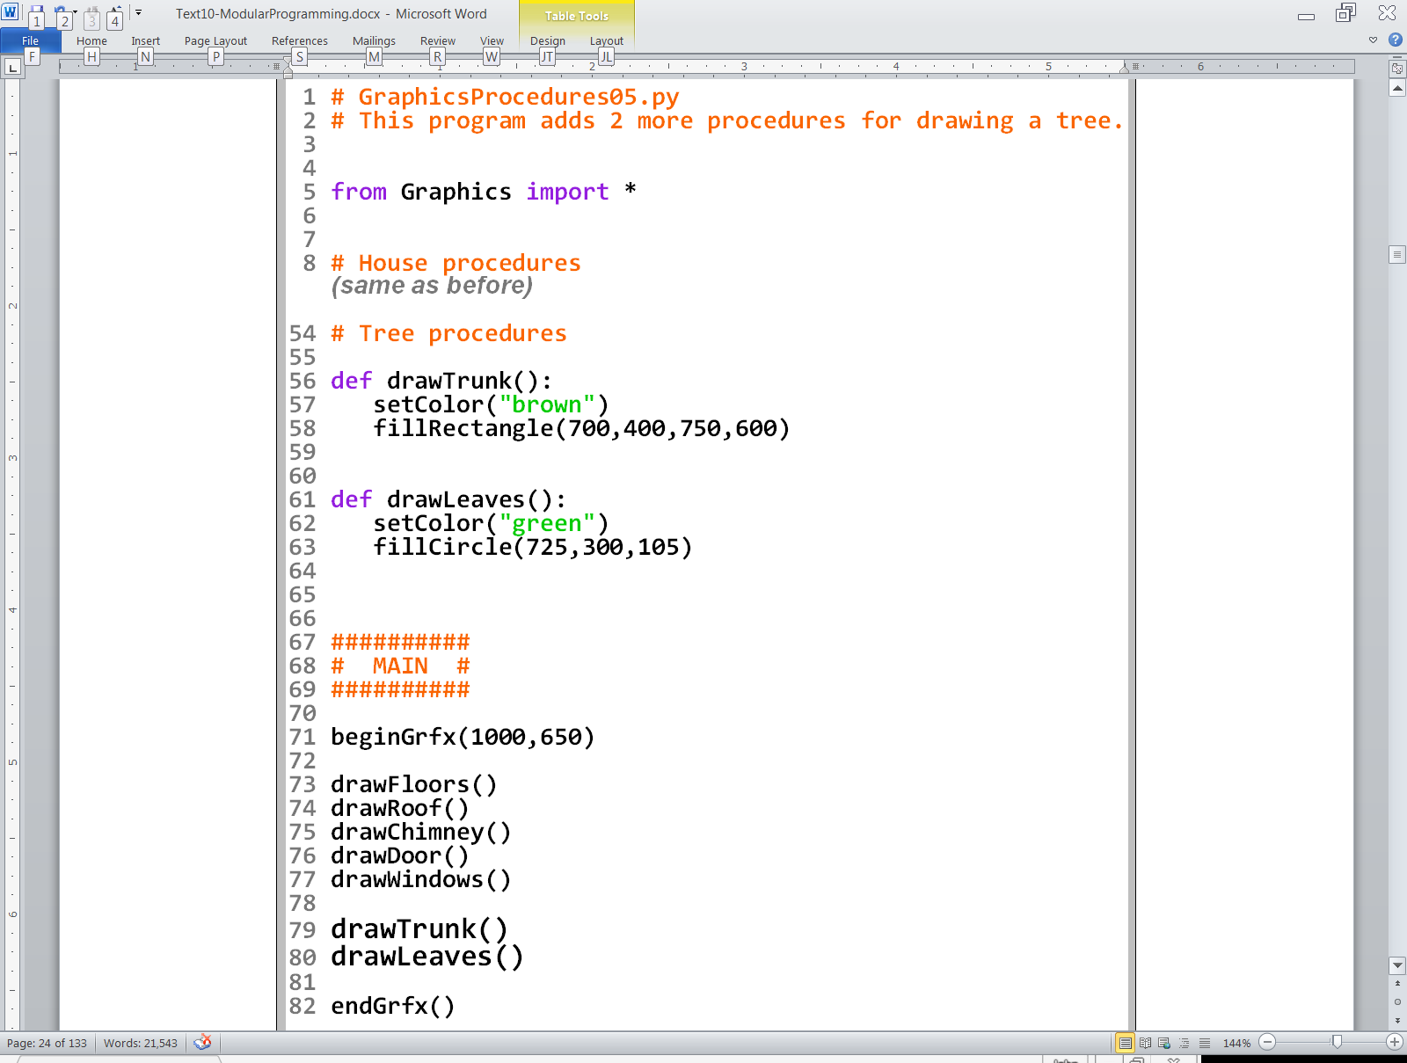
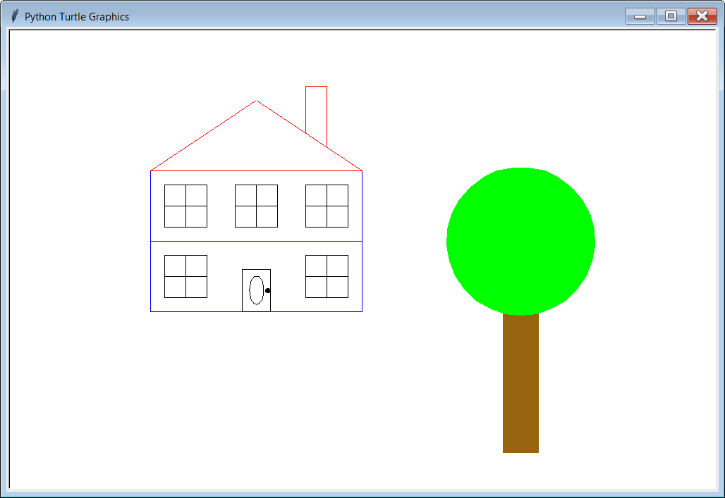

Slide 29
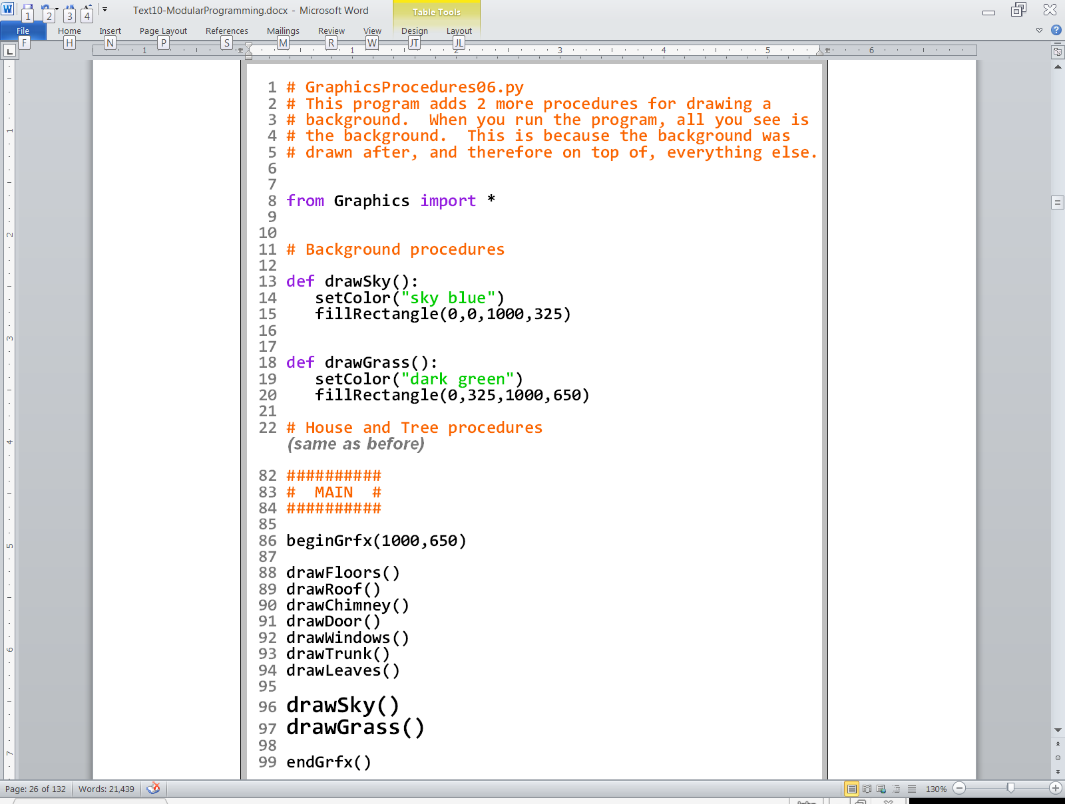
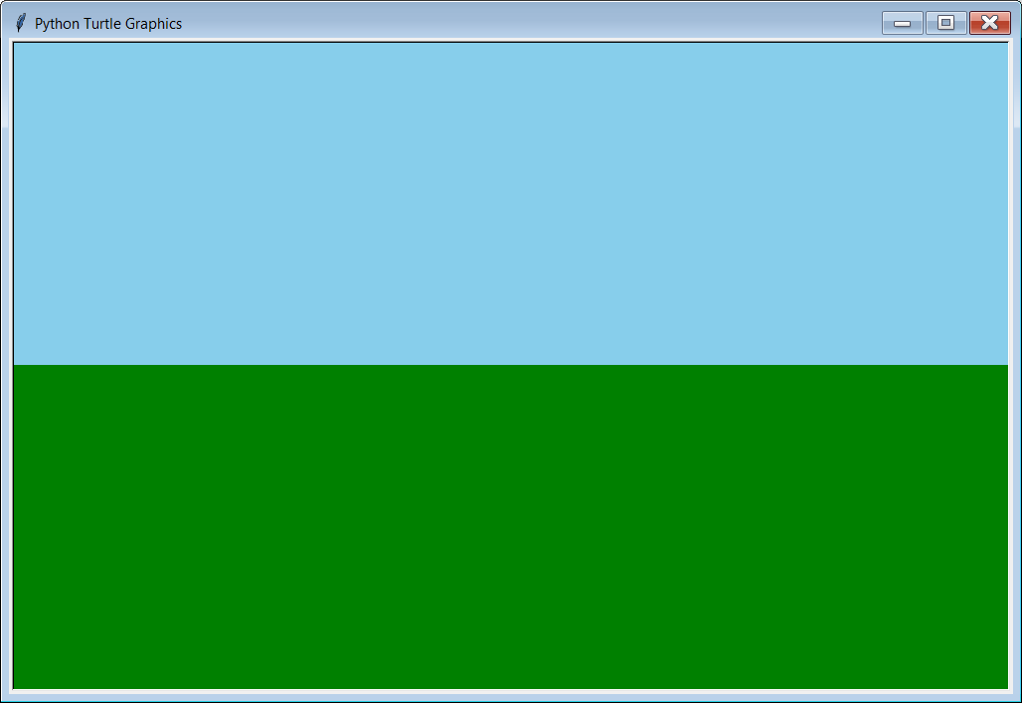

Slide 30
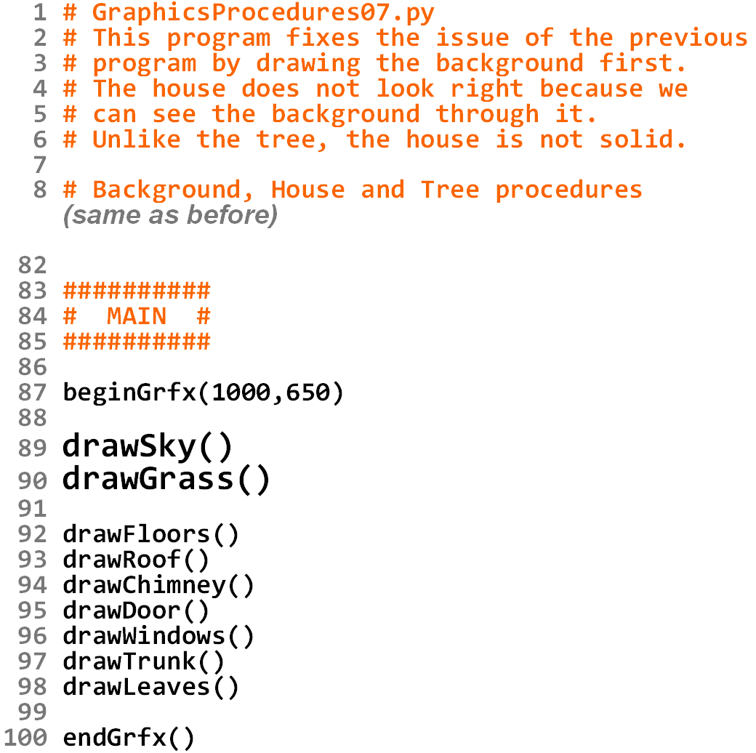
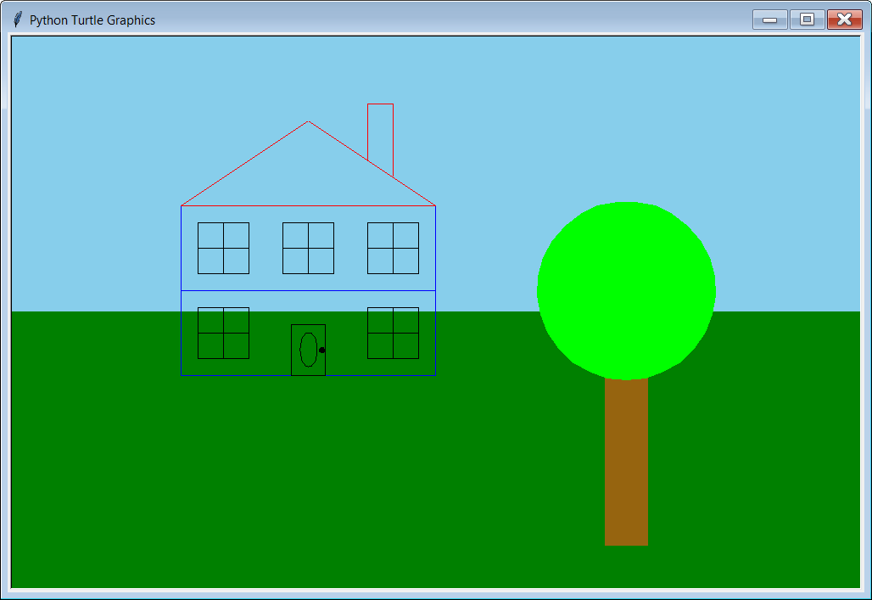

Slide 31
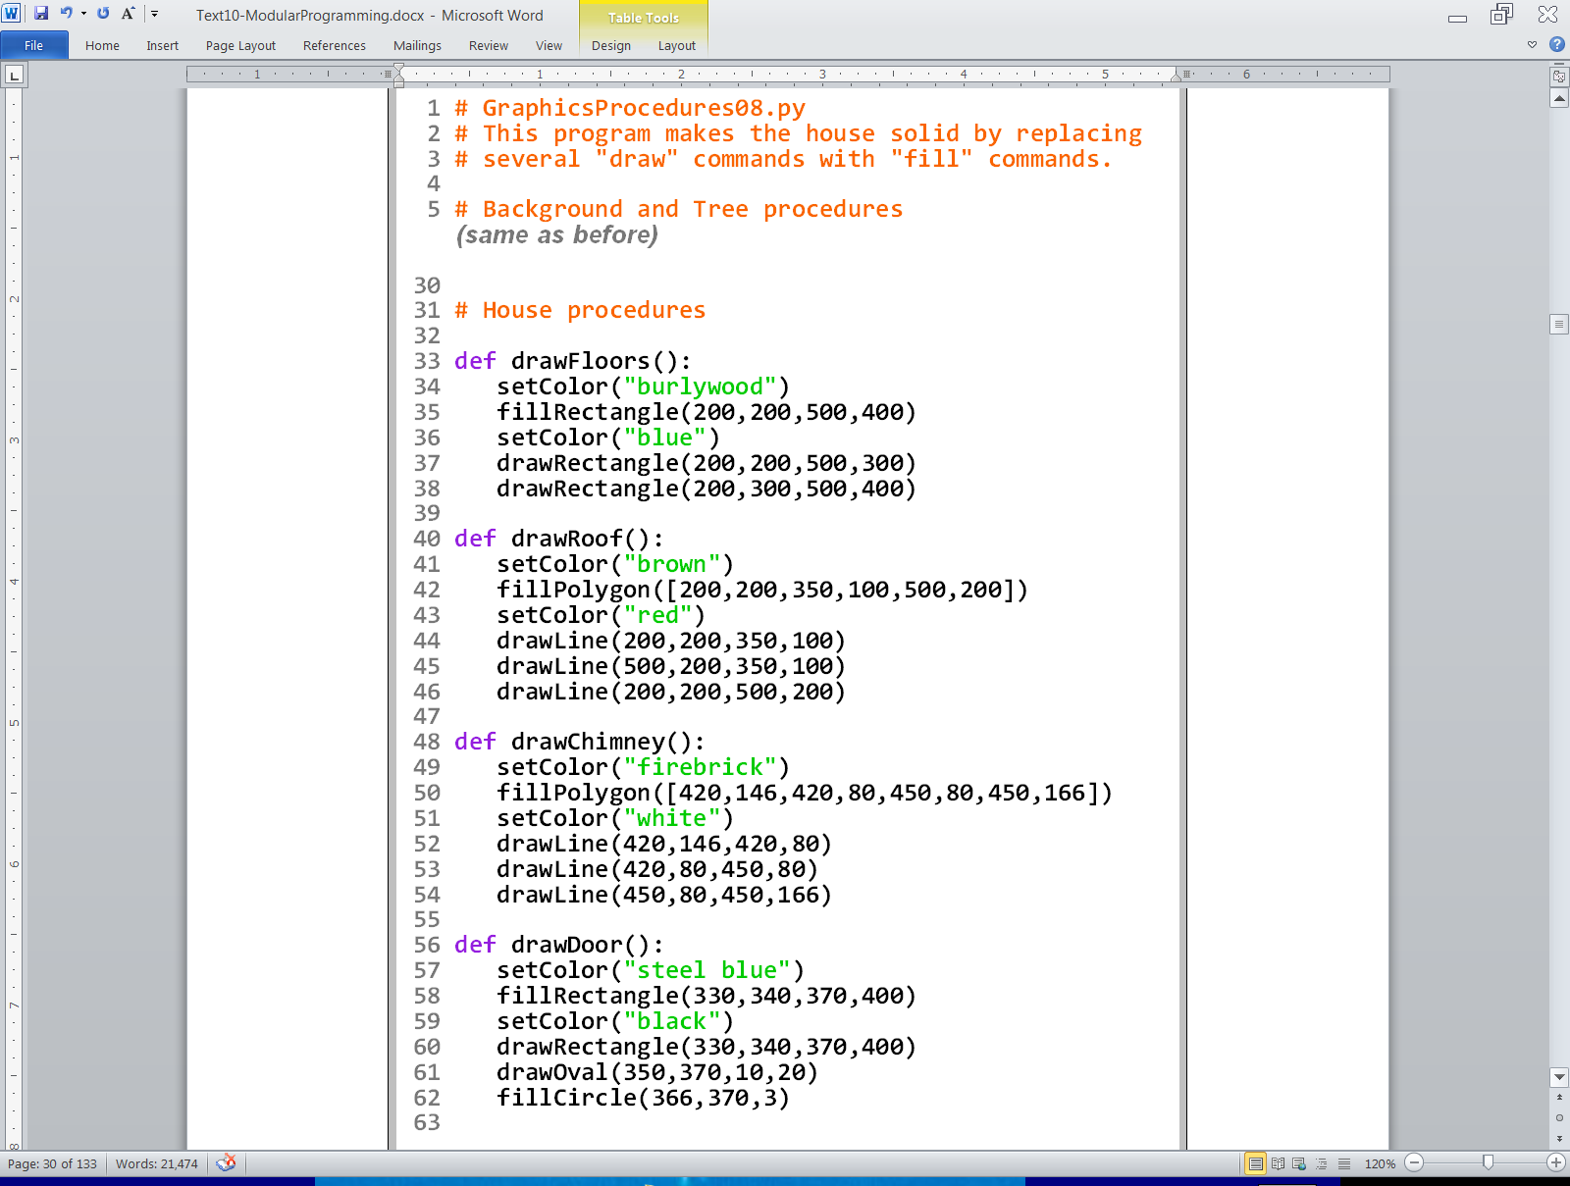
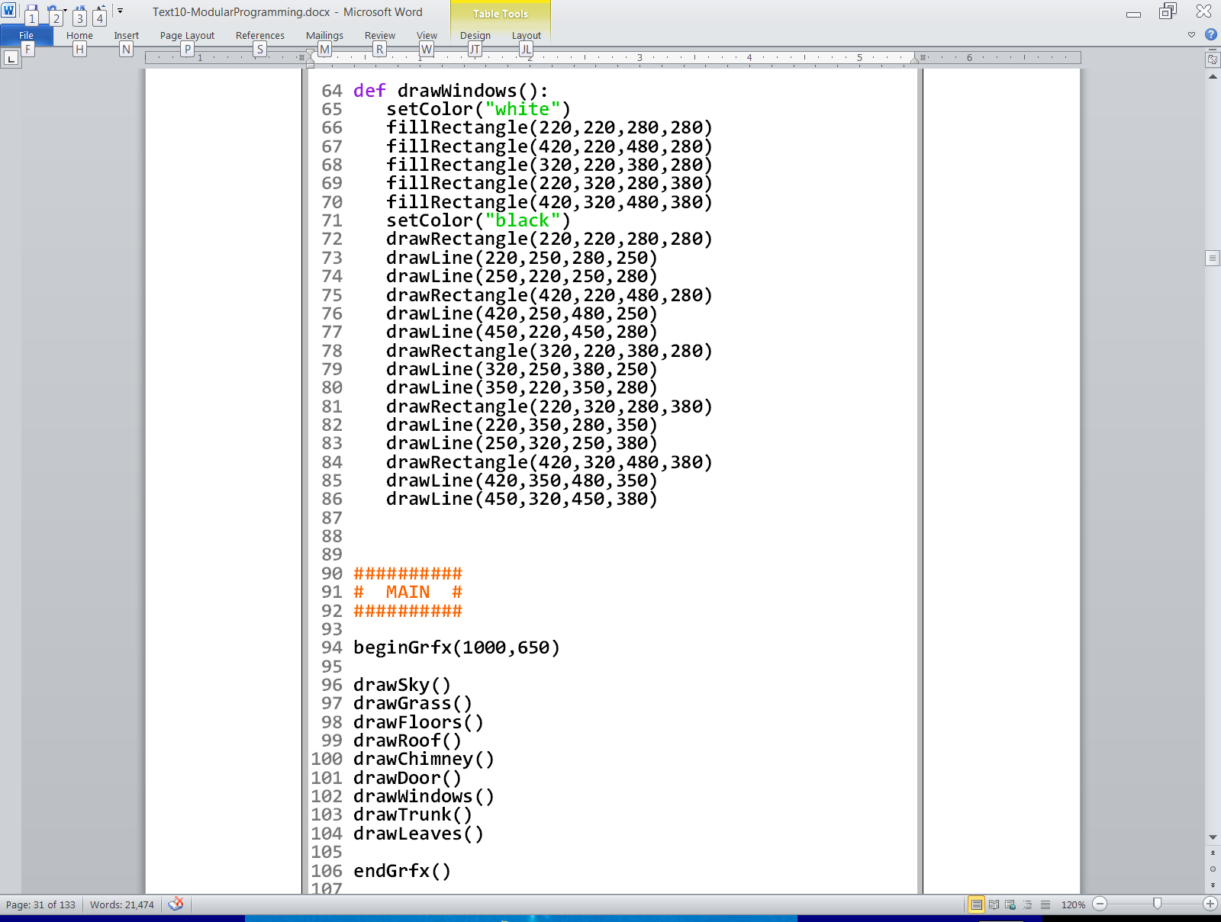

Slide 32
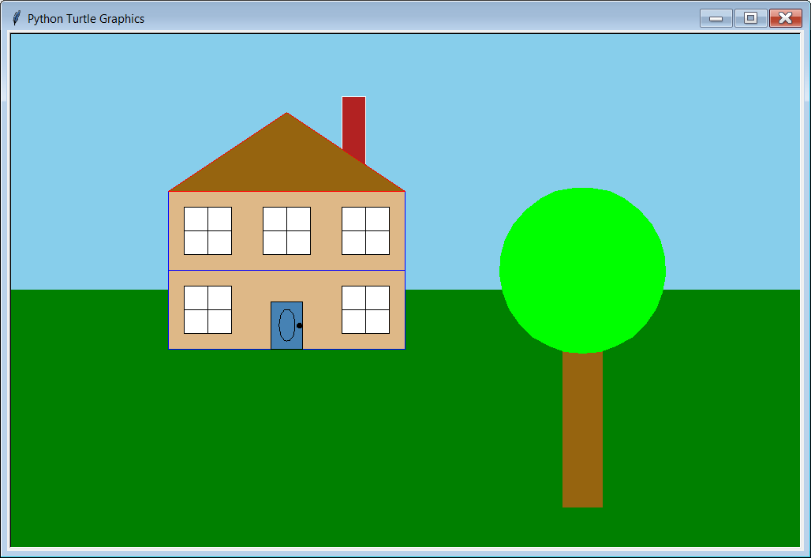

Slide 33
Section 9.5
Creating Your
Own Libraries

Slide 34
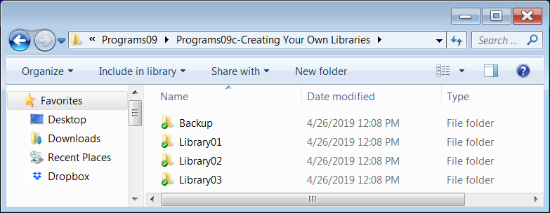
When you open the Programs09c-Creating Your Own Libraries folder, you will see that it is different from the other subfolders in Programs09. Besides Backup, this subfolder simply contains 3 other subfolders:
Since this section is on creating your own libraries, it means that each program example will actually consist of multiple files.
NOTE: Whenever a program consists of more than one file, all of the necessary files for that program should be placed into a single folder.

Slide 35
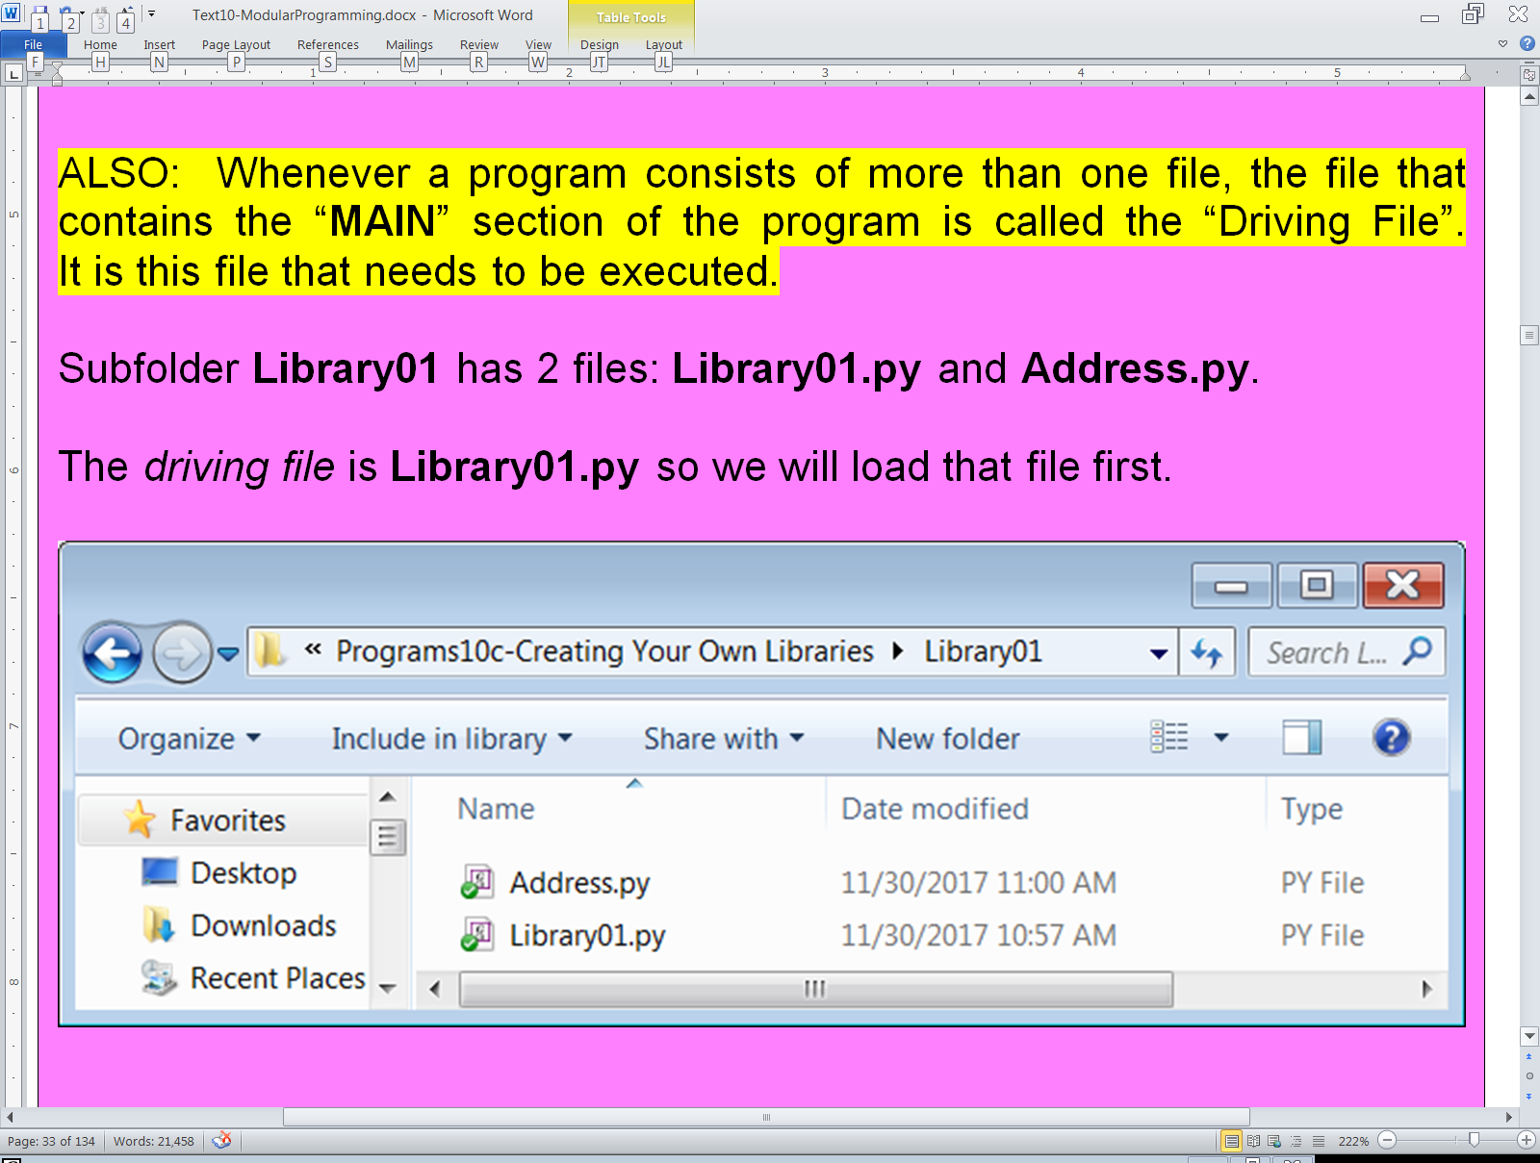
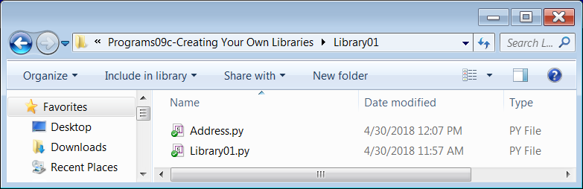

Slide 36
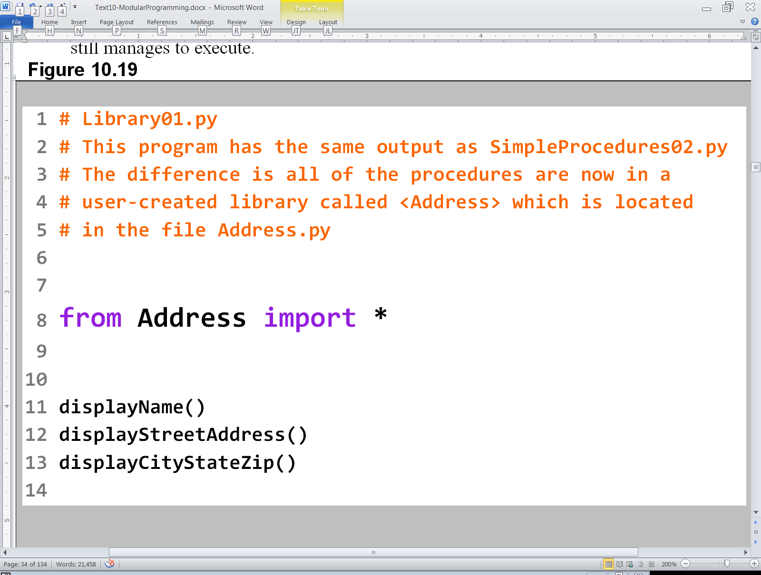

Slide 37

How does this
work without the
three procedure
definitions?

Slide 38
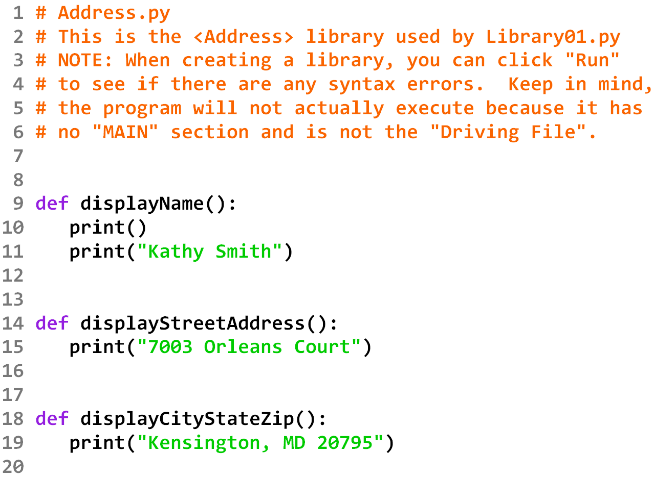
Here they are!

Slide 39
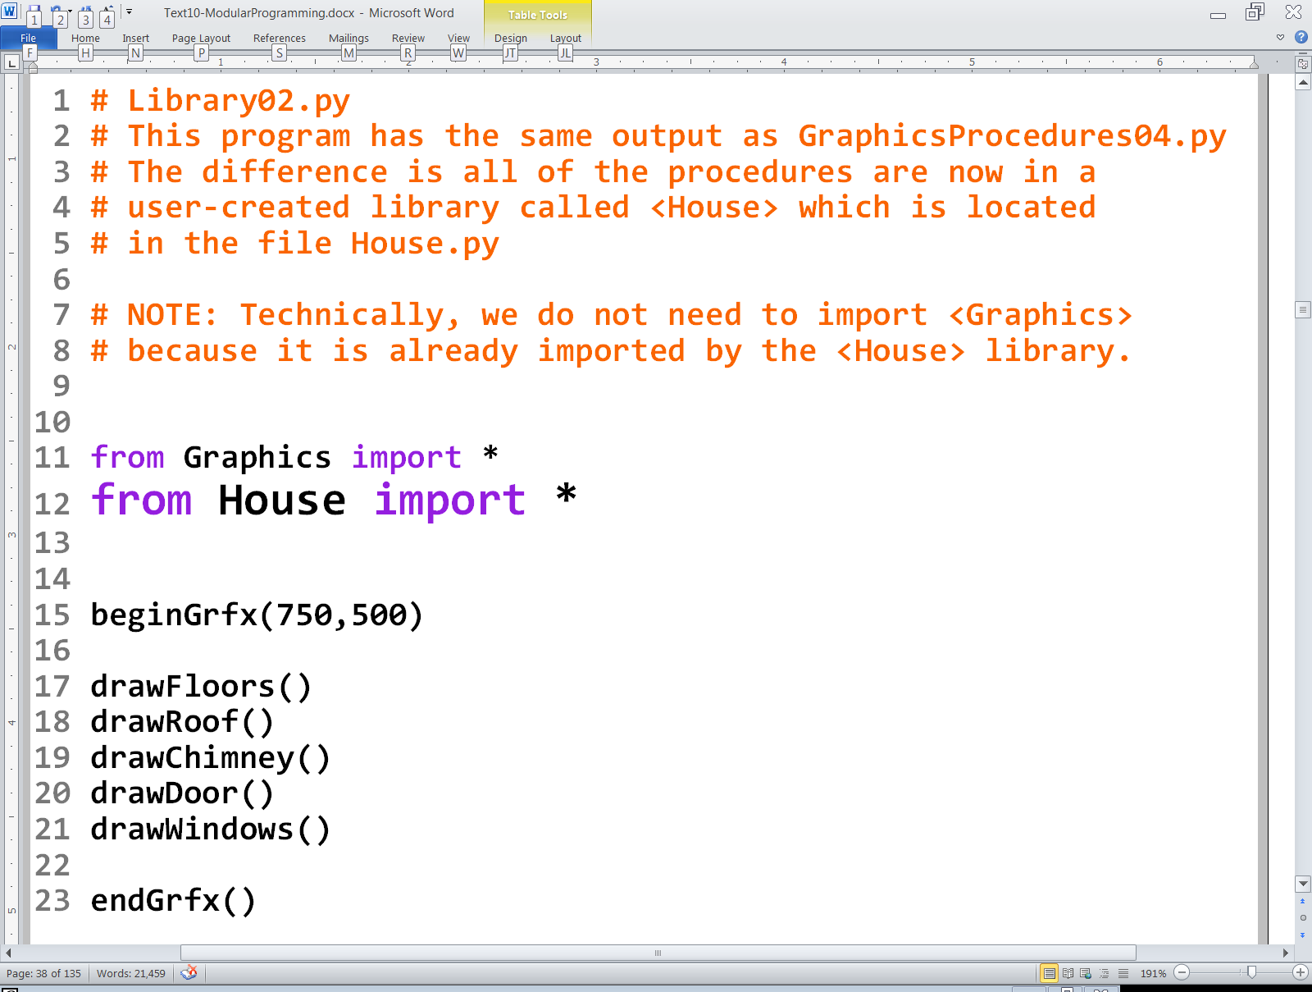


Slide 40
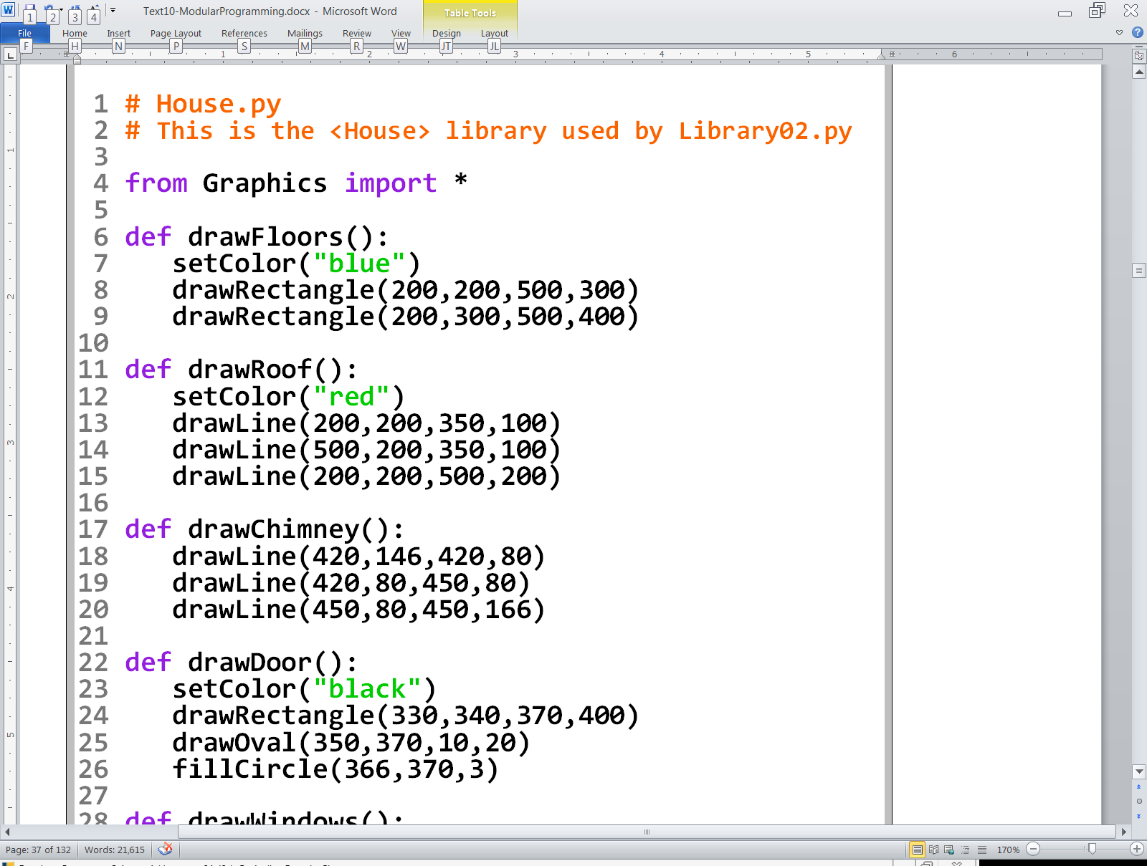
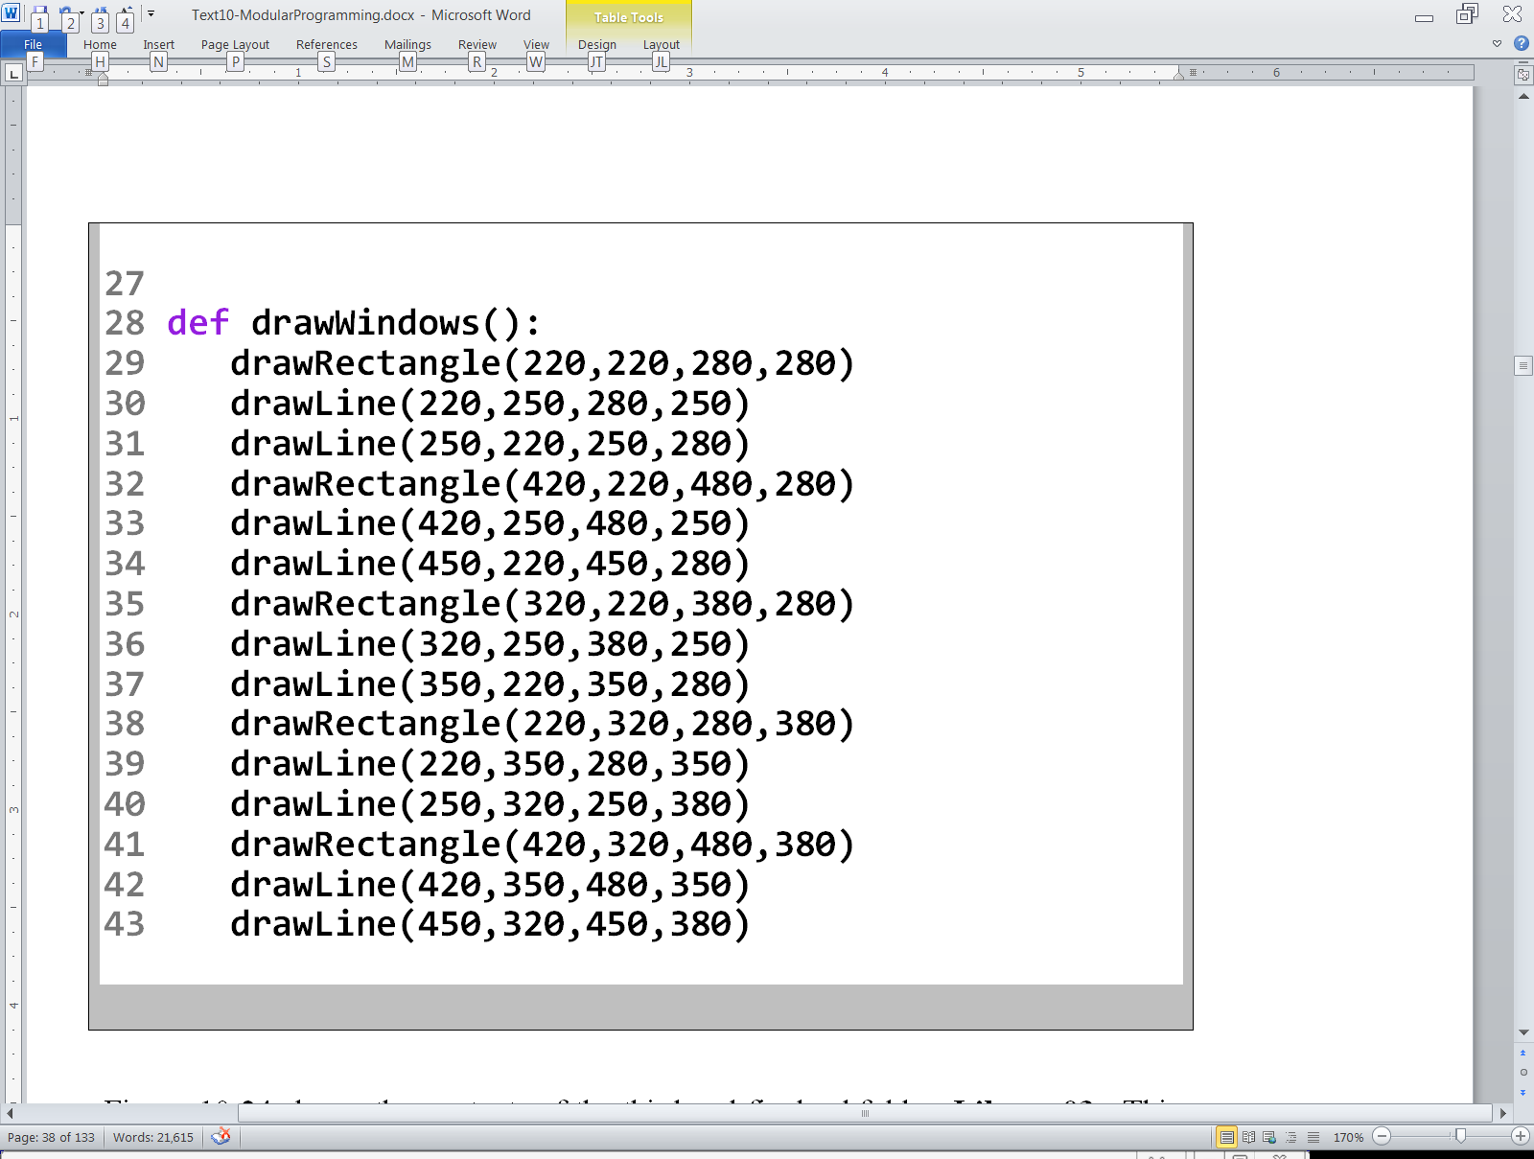

Slide 41
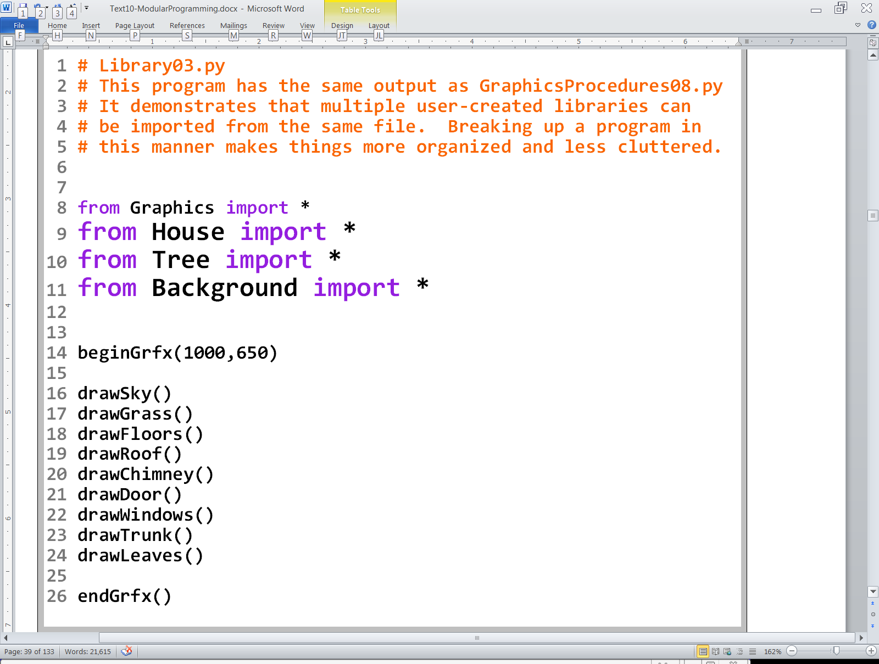


Slide 42
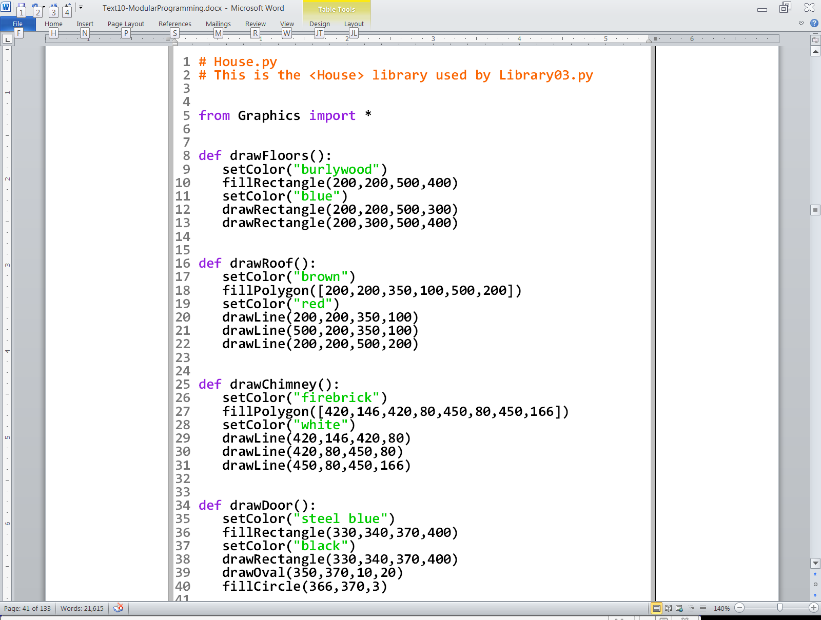
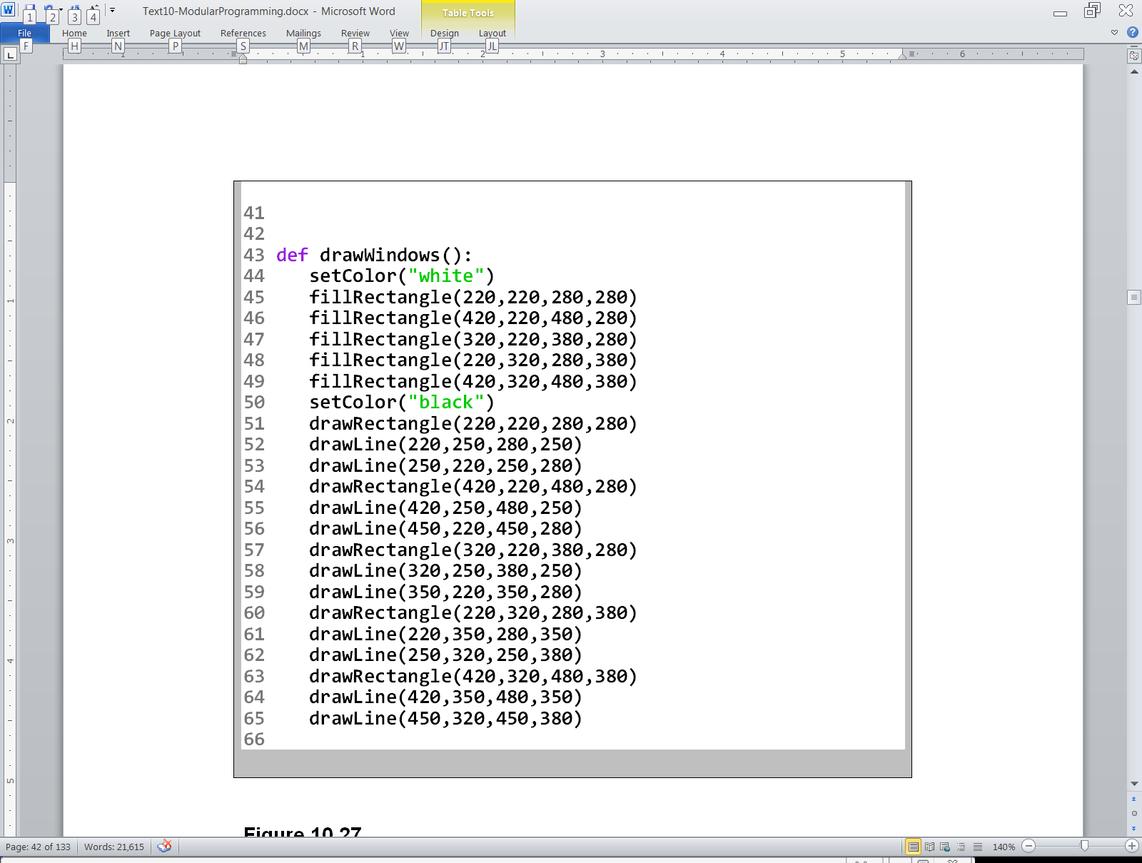

Slide 43
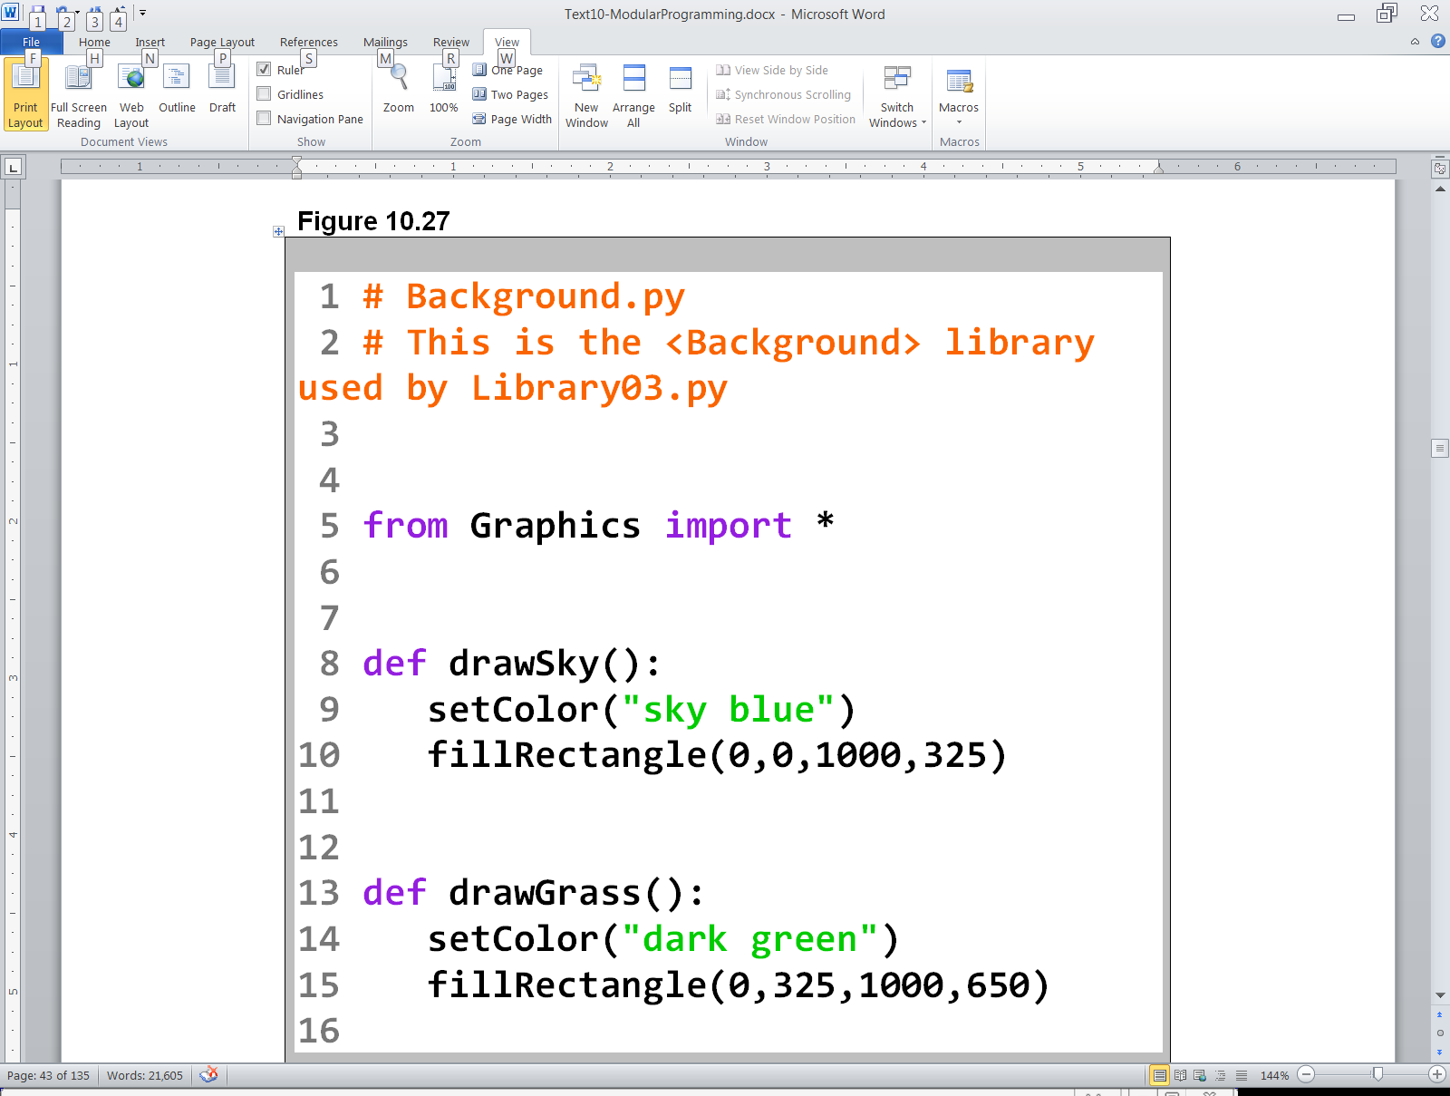
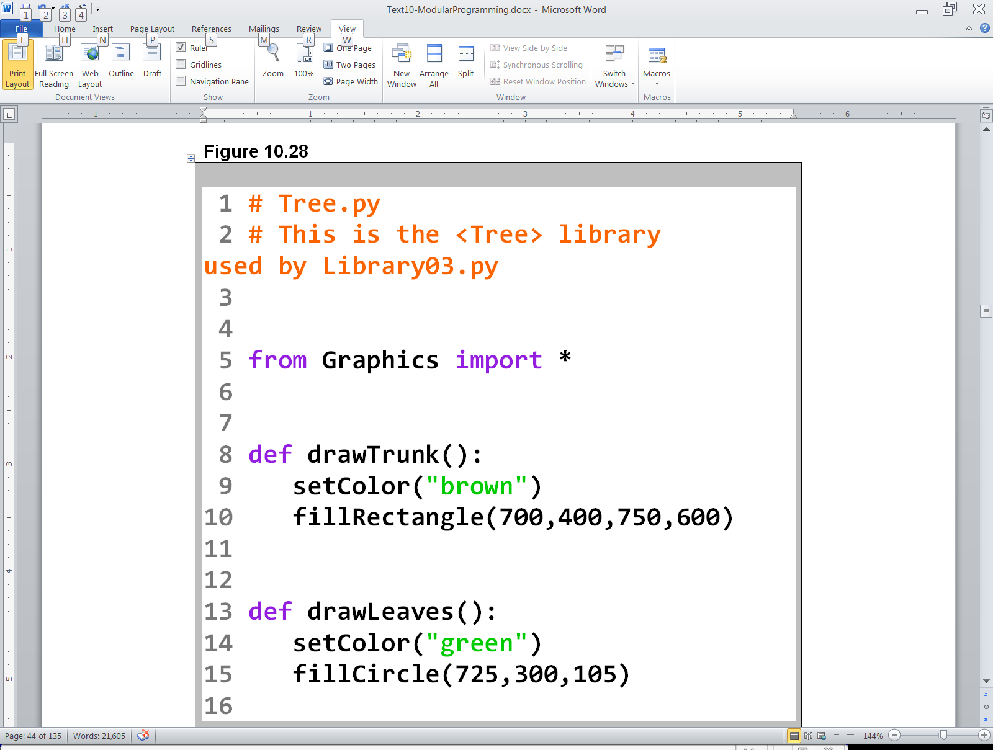

Slide 44

Program Note
While it is proper programming style to put subroutines of a common nature in their own file, thereby creating a library,
most program examples in this textbook will continue to put all subroutines in the same file for simplicity.

Slide 45
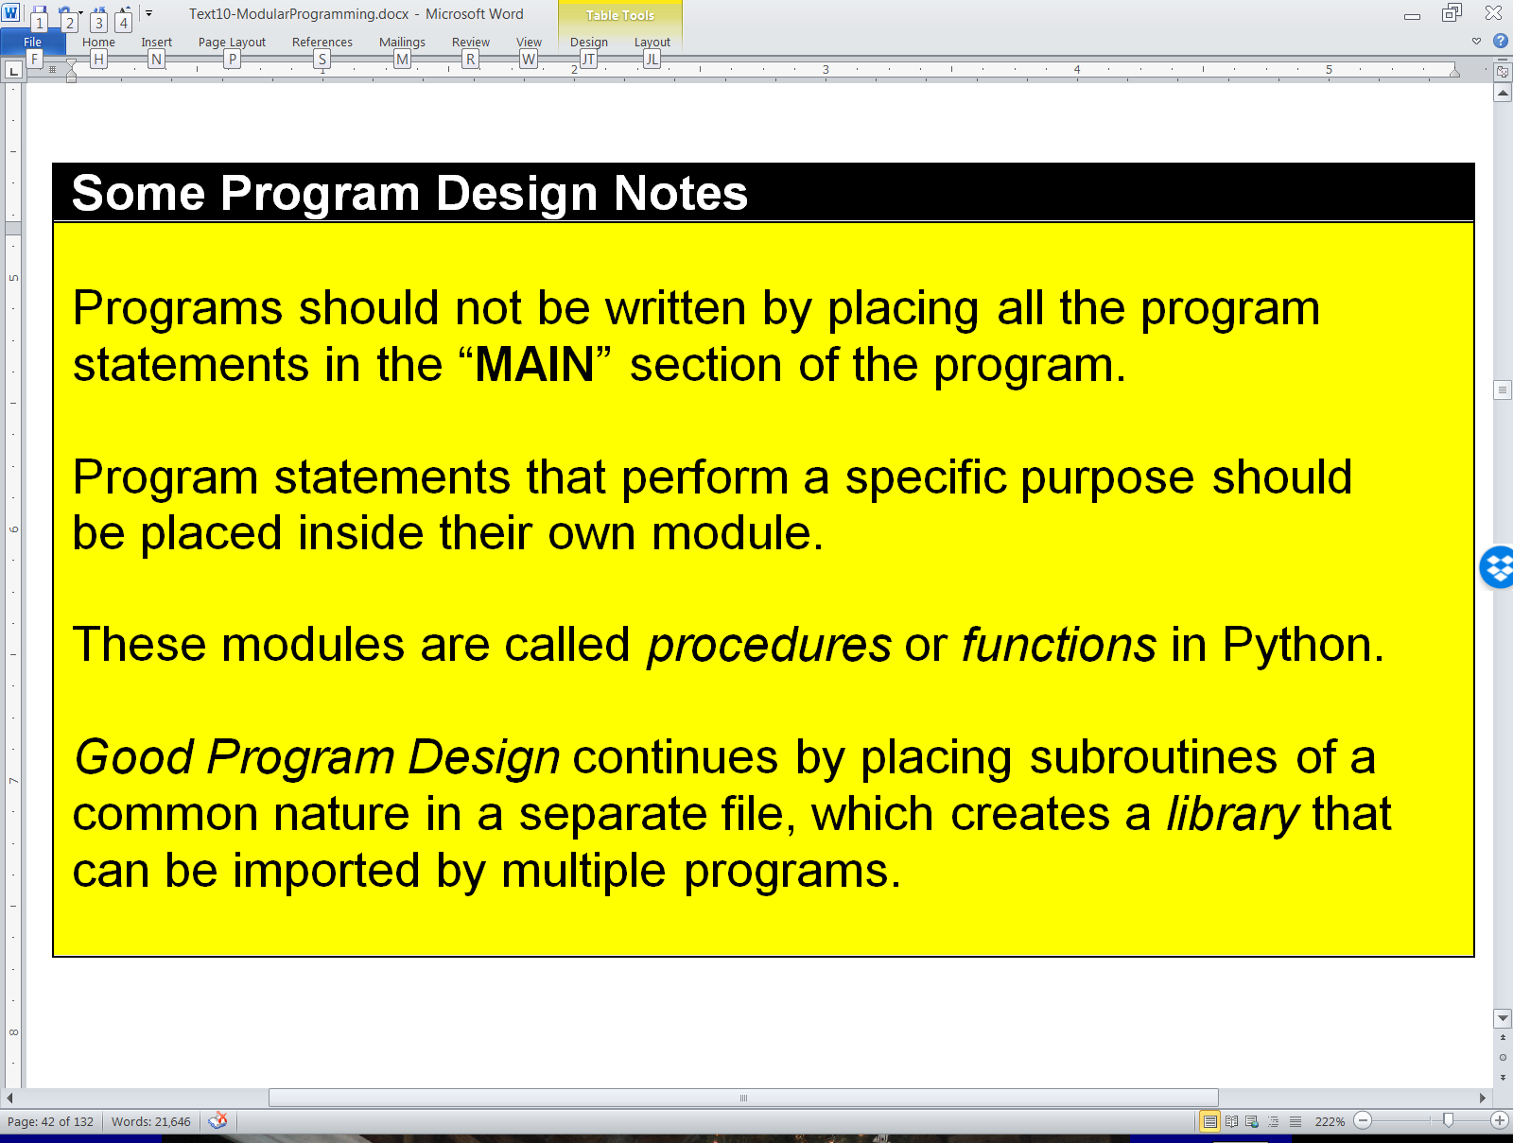
Some Program Design Notes

Slide 46
Section 9.6
Creating a Big
Graphics Program
Step-By-Step

Slide 47
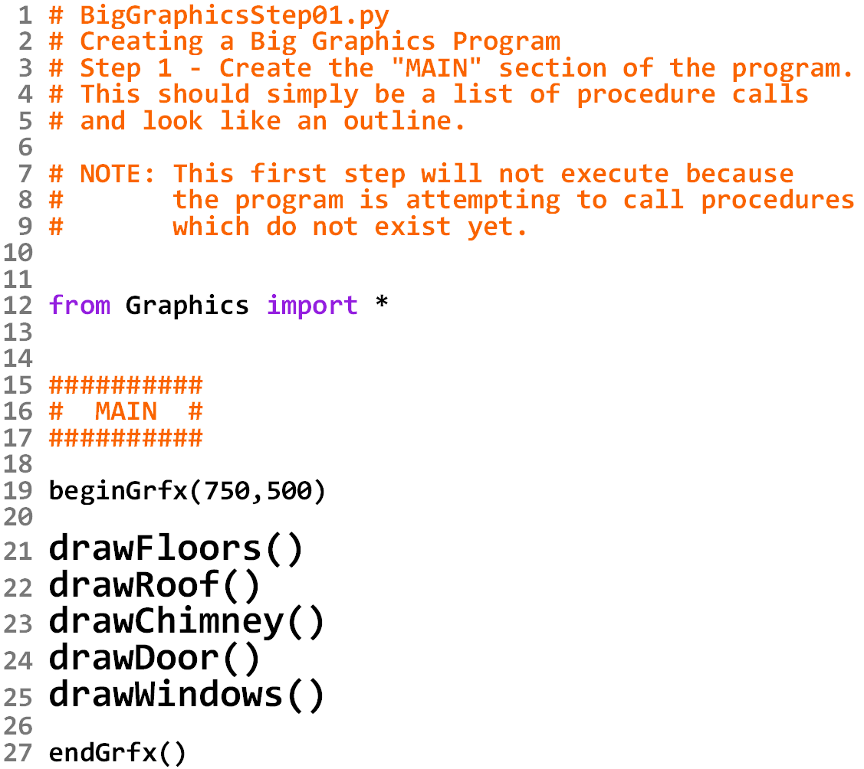

Slide 48


Slide 49



Slide 50


Slide 51


Slide 52


Slide 53


Slide 54


Slide 55



